Slide 1
Horn River Basin Update
24 March 2023

Slide 2
Agenda
Project recap
Project goals
Stratigraphic overview
Sub-regional focus
Land rights
Landing zone analysis
Rock properties
OGIP updates
Fairway mapping
EZone considerations
Conclusion
2

Slide 3
Project Goals
Develop skills in regional mapping and exploration workflows
Expand on previous work to enhance regional knowledge of the Horn River Basin
Create a foundation in Petrel with which more detailed analysis can be done, allowing for a better understand of key geologic and fluid attributes in existing wells
Deliver basin-wide models for stratigraphy, gas data, rock properties, and OGIP; analyze historical development trends to identify primary landing zones and potential play fairways
3

Slide 4
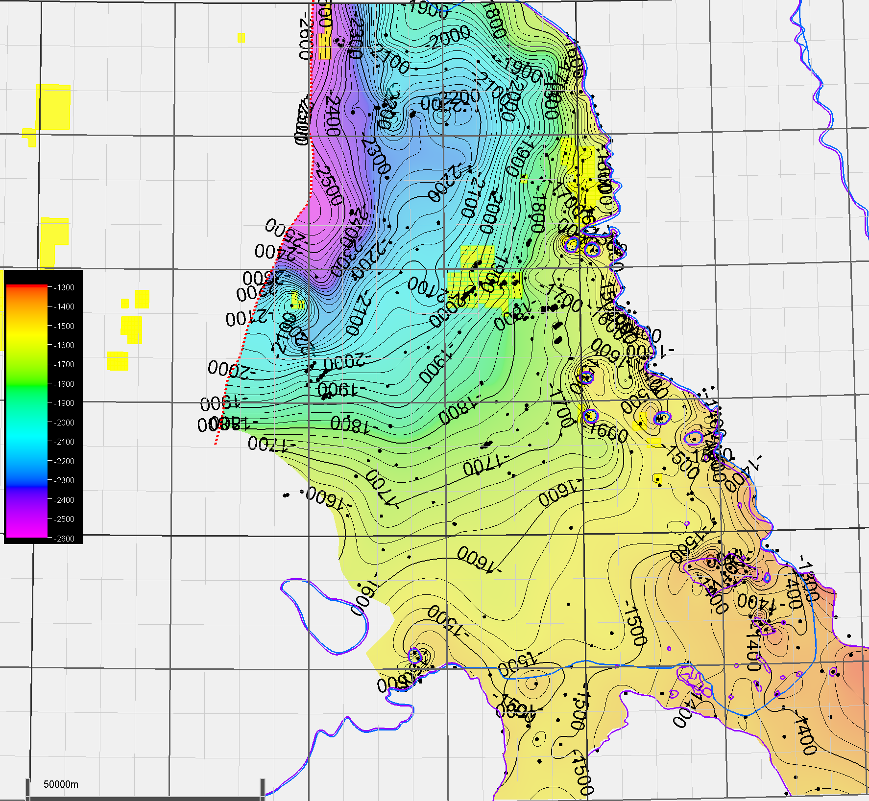
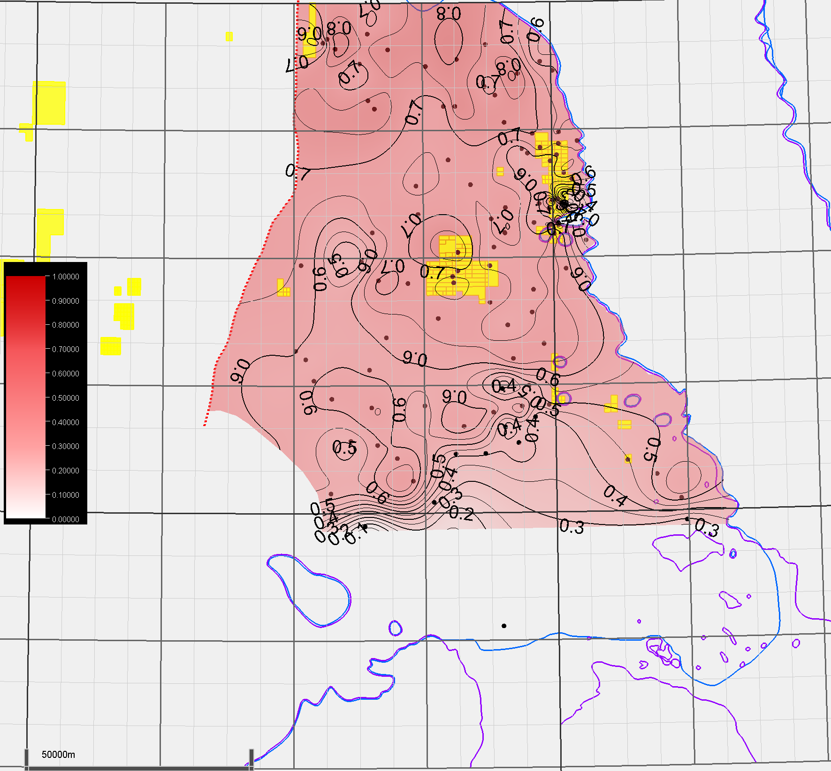
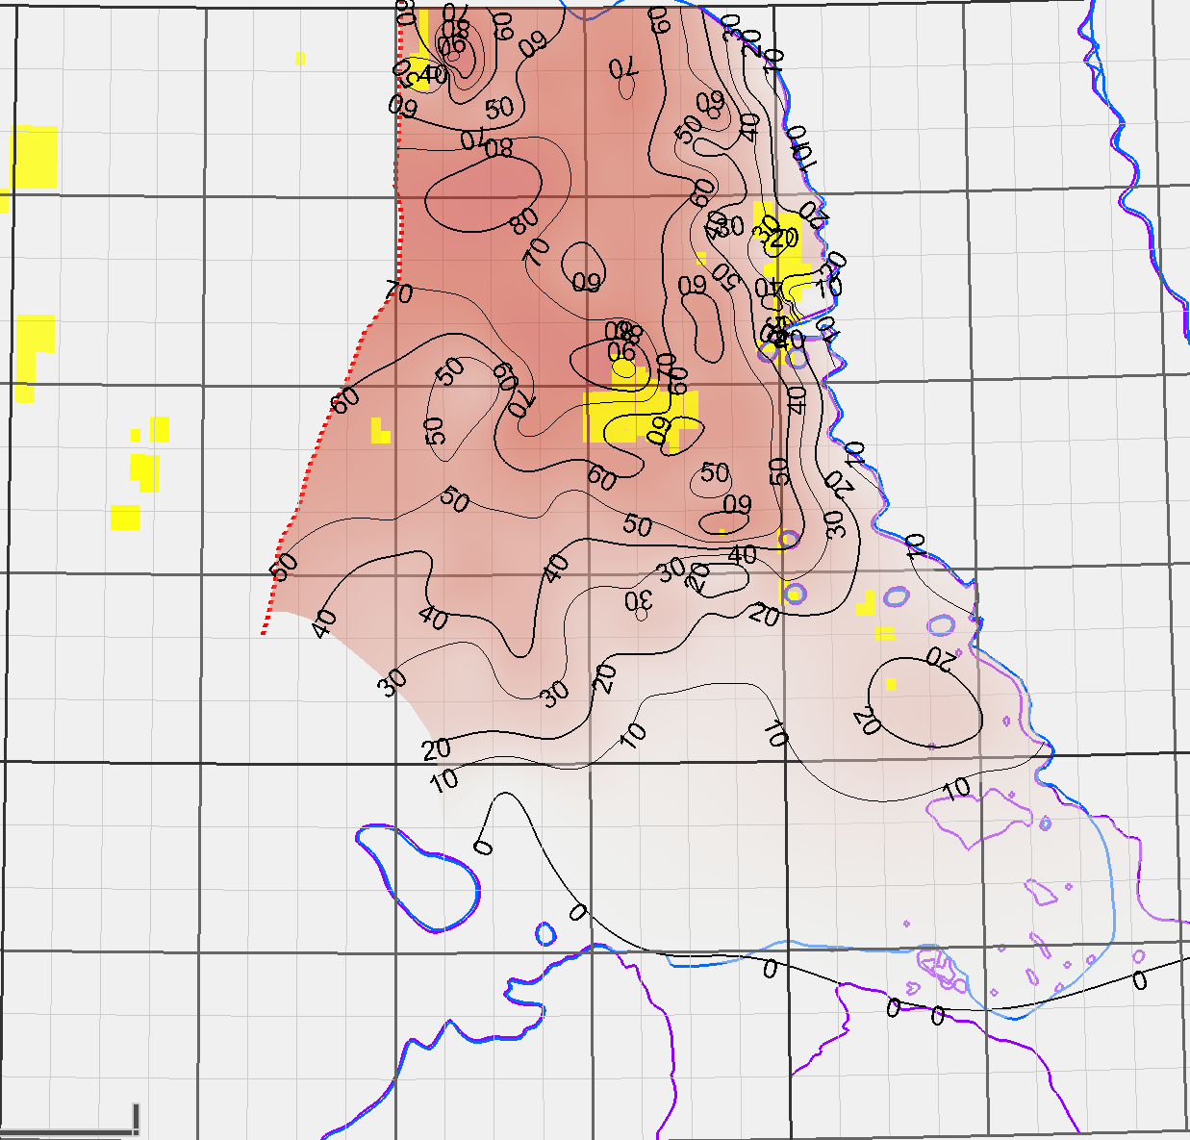
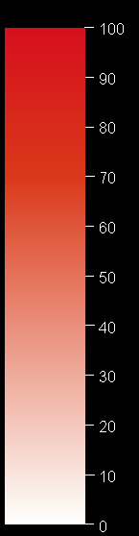
Recap
25 m contour interval
Structural mapping
Well data imports, log QC, tops picking
Property models
Integrate existing petrophysics
Mineralogy, porosity, water saturation
OGIP calculations
Regional Bg estimates
0.05 contour interval
Muskwa structure
10 bcf/sec contour interval
Muskwa Sg
4
Muskwa OGIP

Slide 5
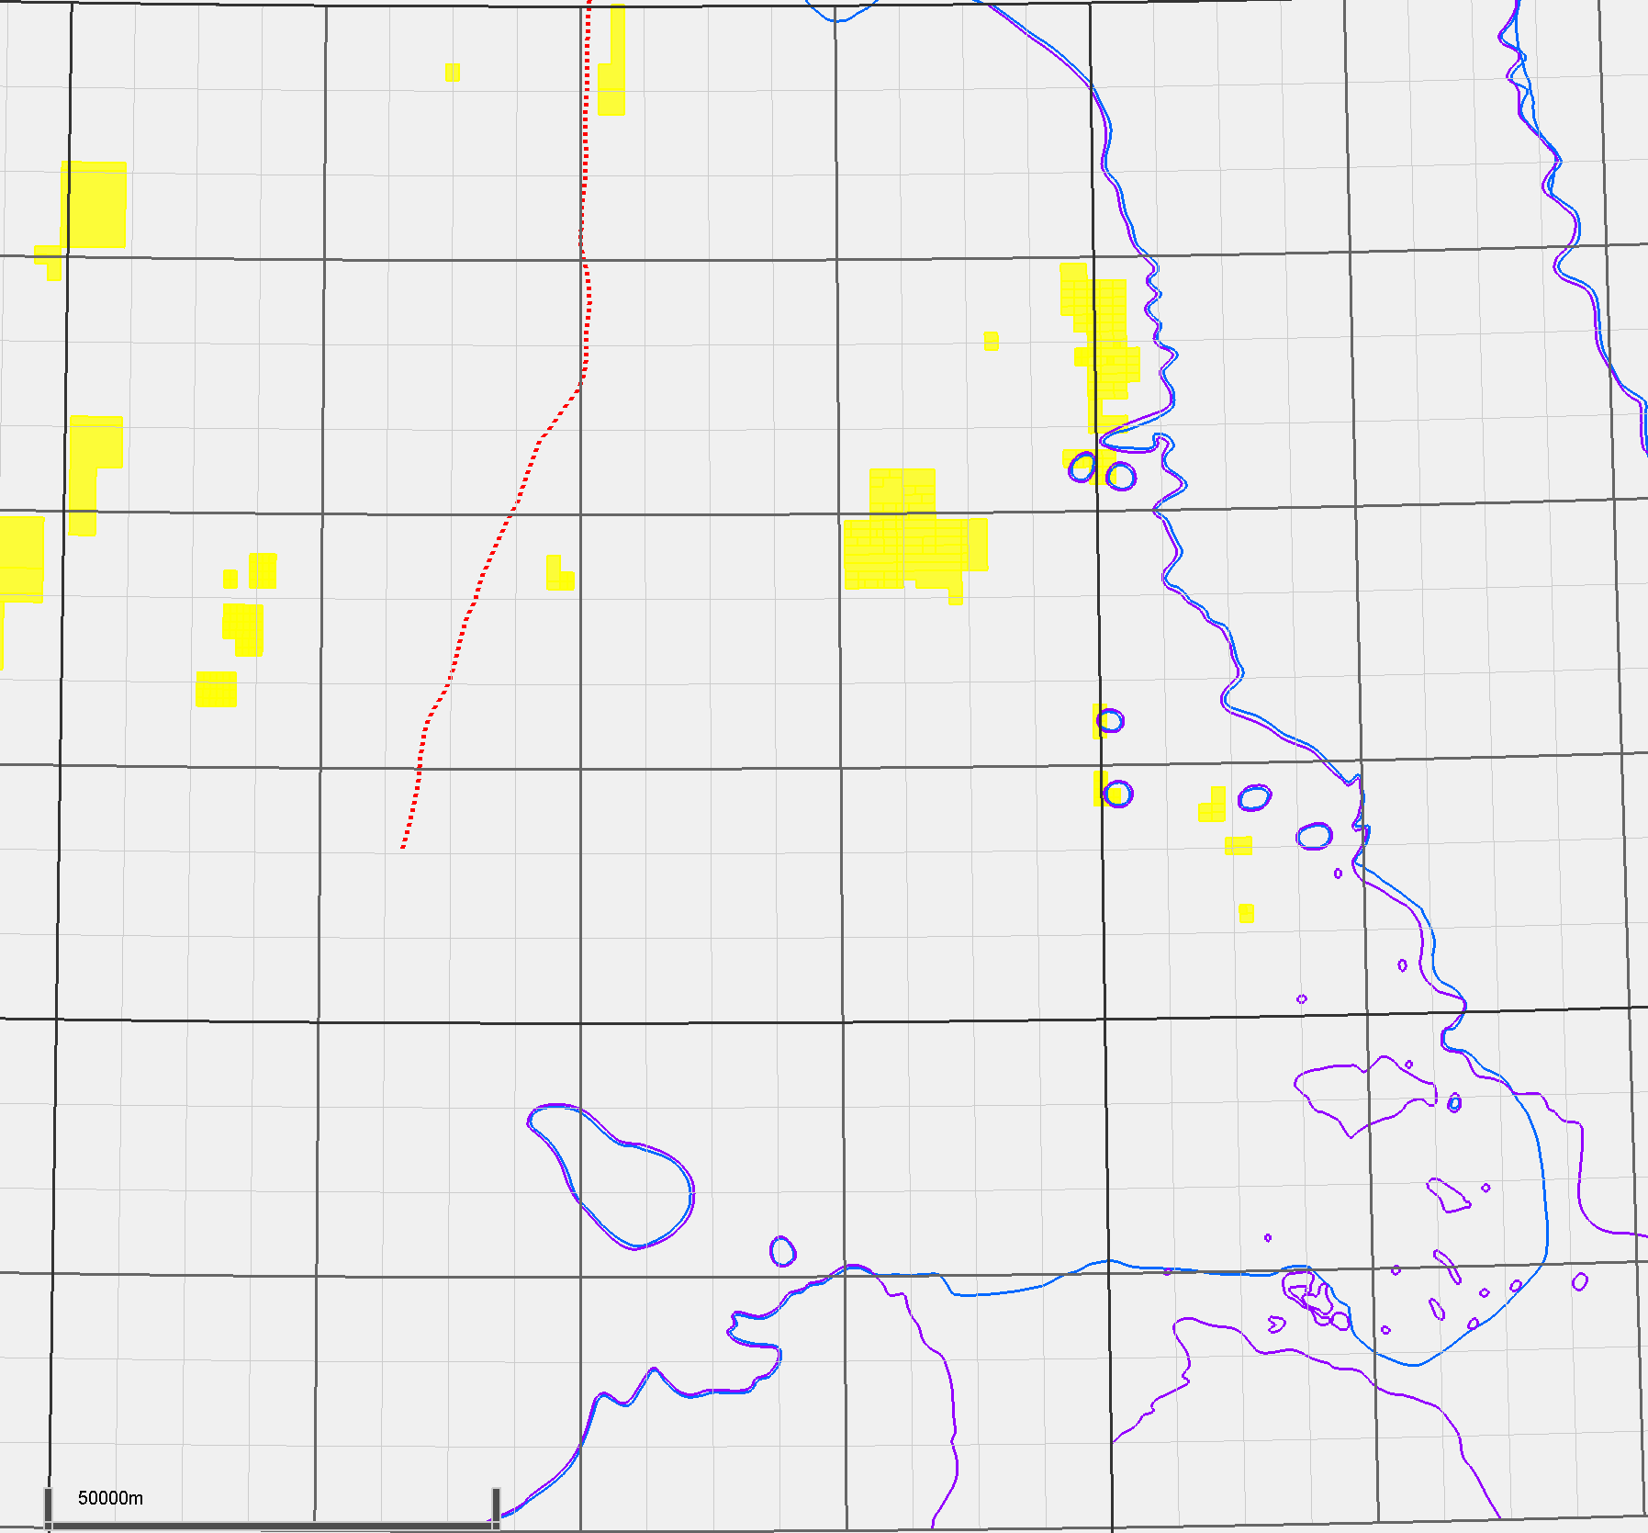
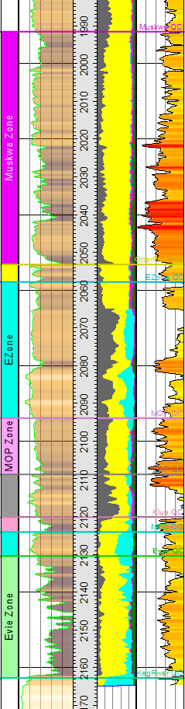
Stratigraphic Overview
200-d-052-L-094-O-08/00
NWT
Three landing zones identified:
Muskwa-Upper Otter Park
Middle Otter Park
Evie
Mineral
content
GR
φ
Maxhamish
Cordova Embayment
MUSKWA
Liard Basin
Ootla
Muskwa-
OP
Bovie Fault System
Etsho
OTTER PARK
E-ZONE
Slave Point Reefs
EZone
MOP
MOP
LOP-MDC
LOP
KLUA
MDC
EVIE
Evie
Presqu’ile Reefs
KEG RIVER
5
Muskwa and Upper Otter Park as one package

Slide 6
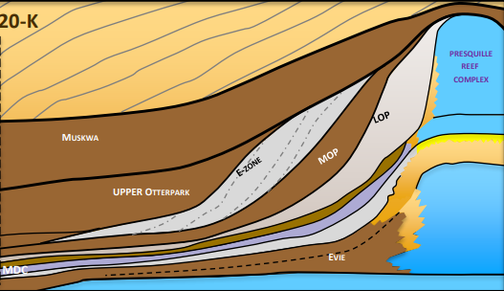

Stratigraphic Overview
200-d-052-L-094-O-08/00
Mineral
content
GR
φ
MUSKWA
SLAVE POINT
REEF
Muskwa-
OP
FORT SIMPSON
LOP
OTTER PARK
MUSKWA
E-ZONE
MOP
EZone
E-ZONE
UPPER OTTER PARK
HORN RIVER MEMBER
PRESQU’ILE
REEF
MOP
MOP
LOP-MDC
LOP
KLUA
MDC
KLUA
EVIE
EVIE
MDC
Evie
KEG RIVER
NW
Adapted from legacy work
SE
KEG RIVER
6
Muskwa and Upper Otter Park as one package

Slide 7
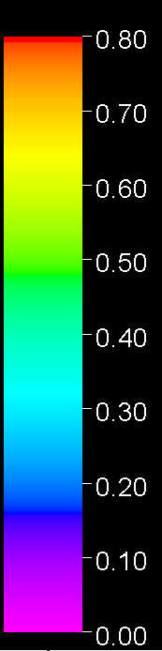
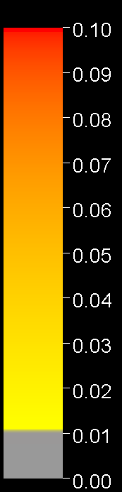
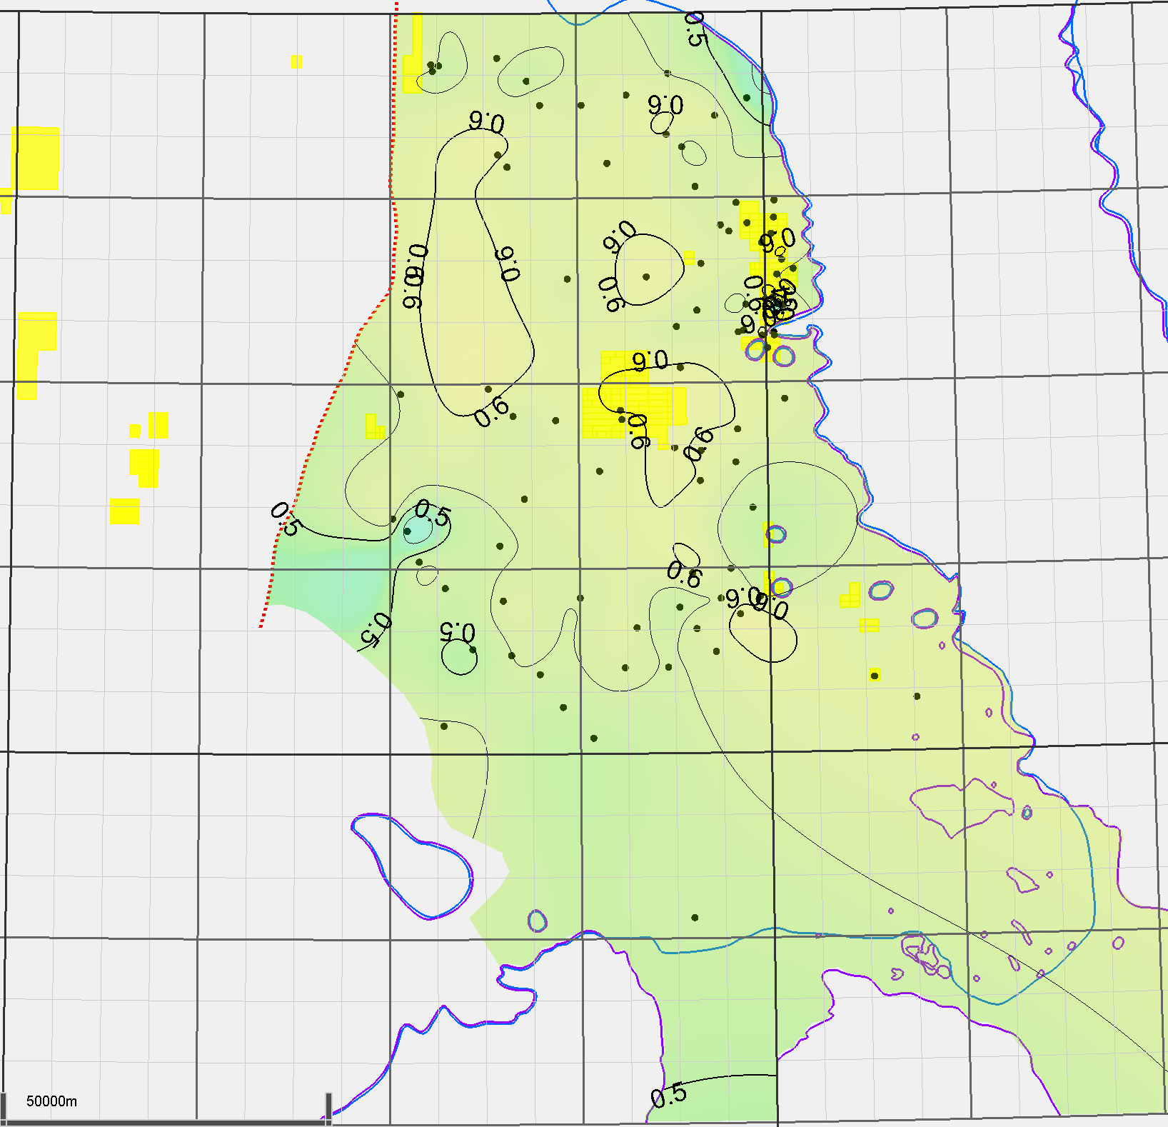
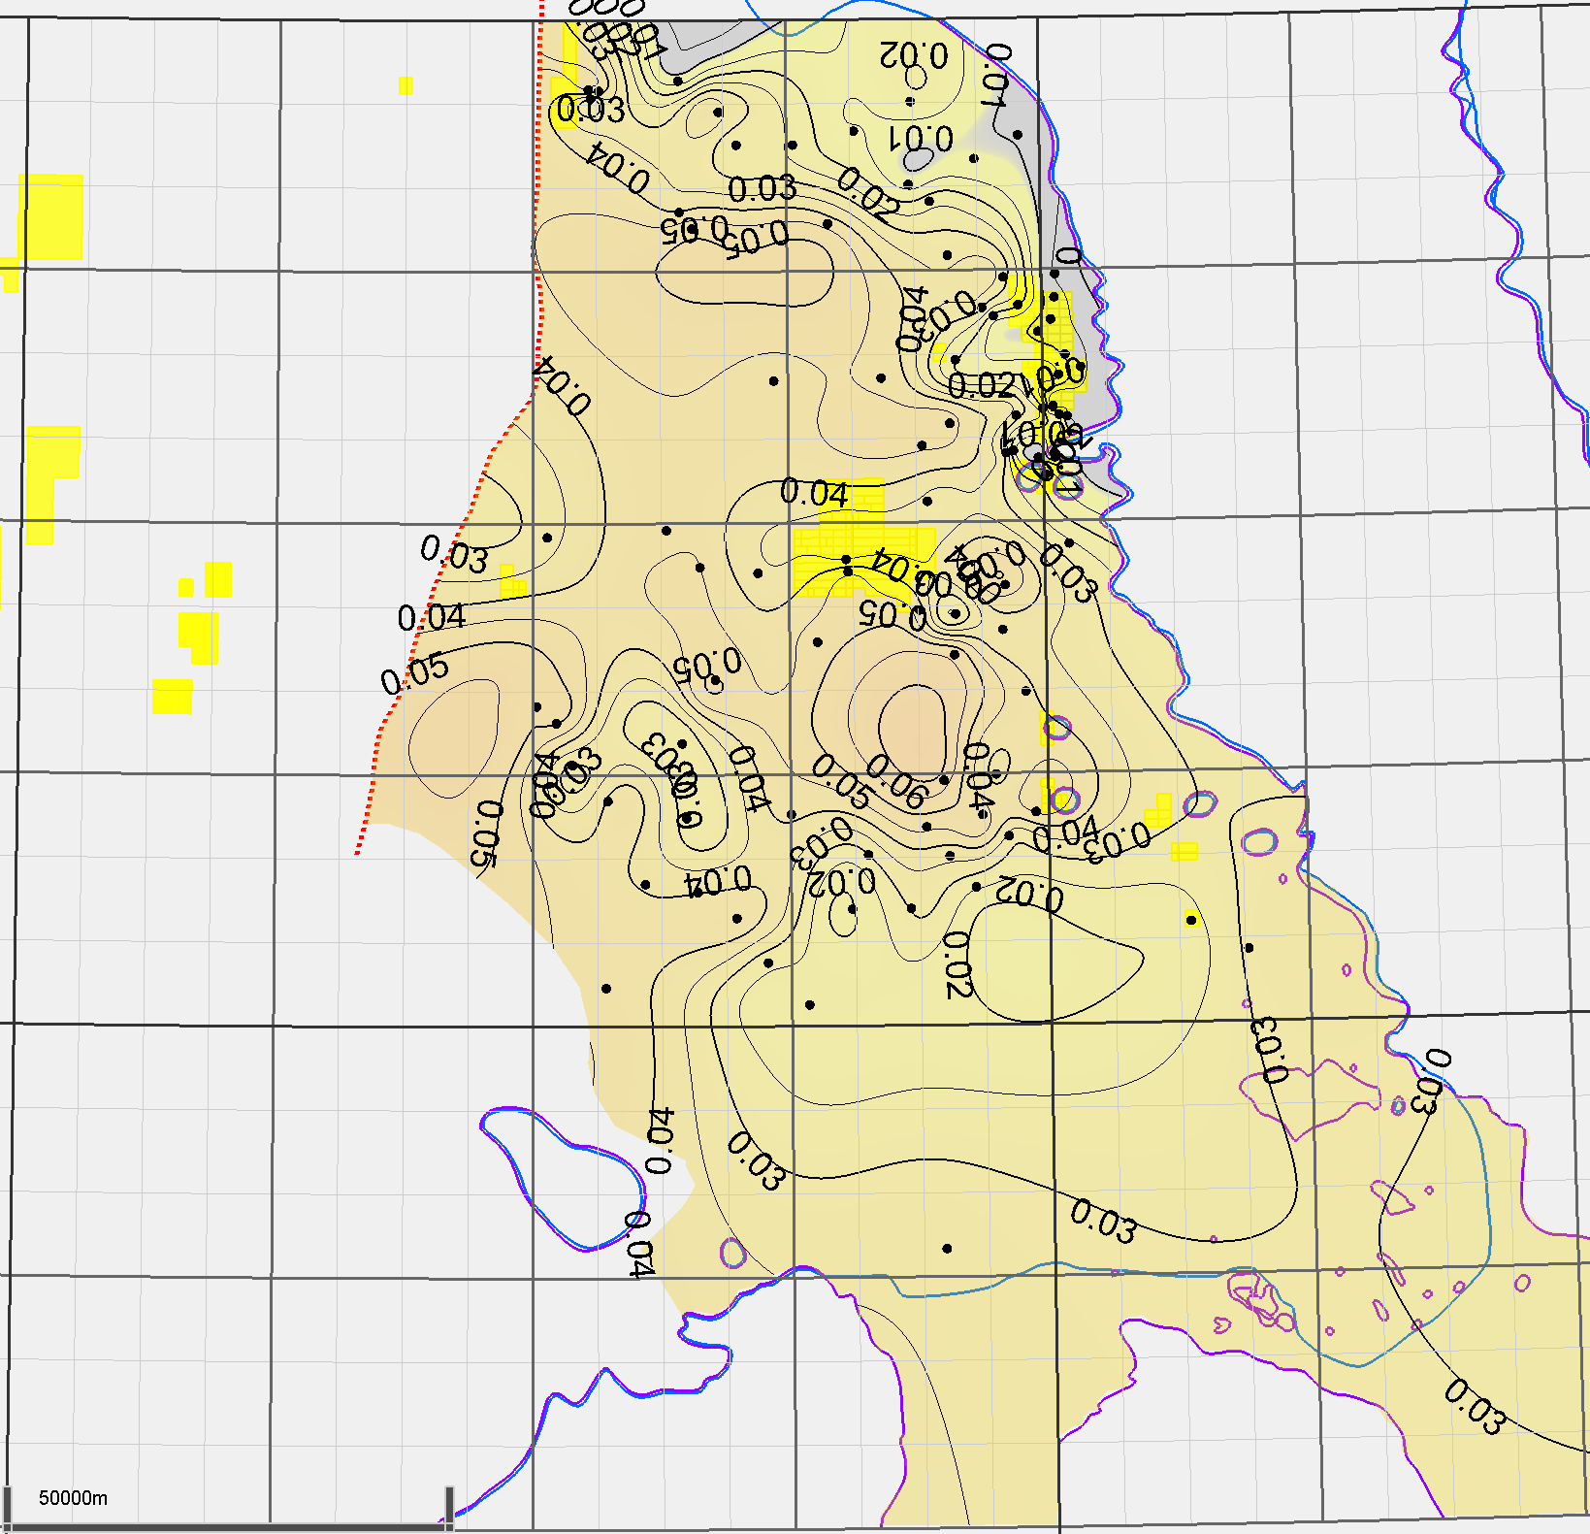
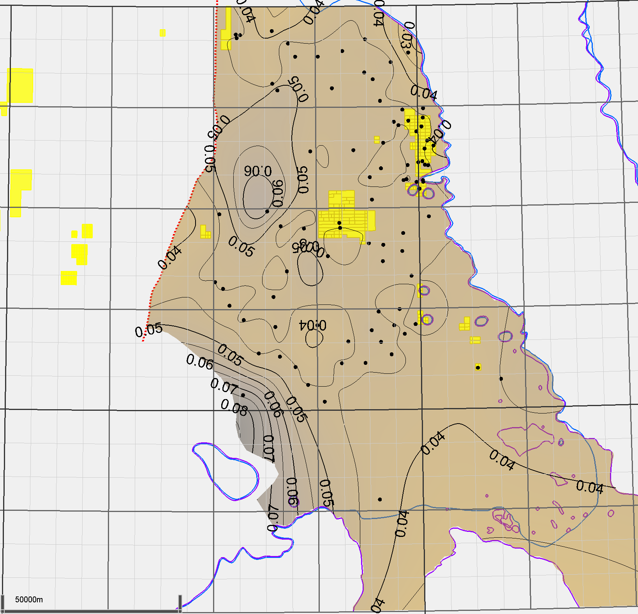
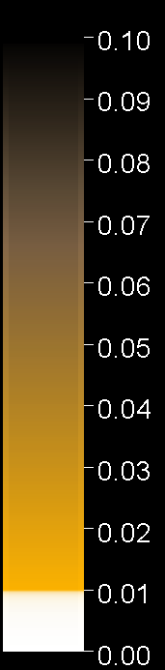
Evie Property Maps
200-d-052-L-094-O-08/00
Porosity
Quartz
Mineral
content
GR
φ
0.005 contour interval
0.05 contour interval
MUSKWA
Muskwa-
OP
OTTER
PARK
TOC
E-ZONE
EZone
MOP
MOP
LOP-MDC
LOP
KLUA
MDC
EVIE
Evie
KEG RIVER
0.005 contour interval
7

Slide 8
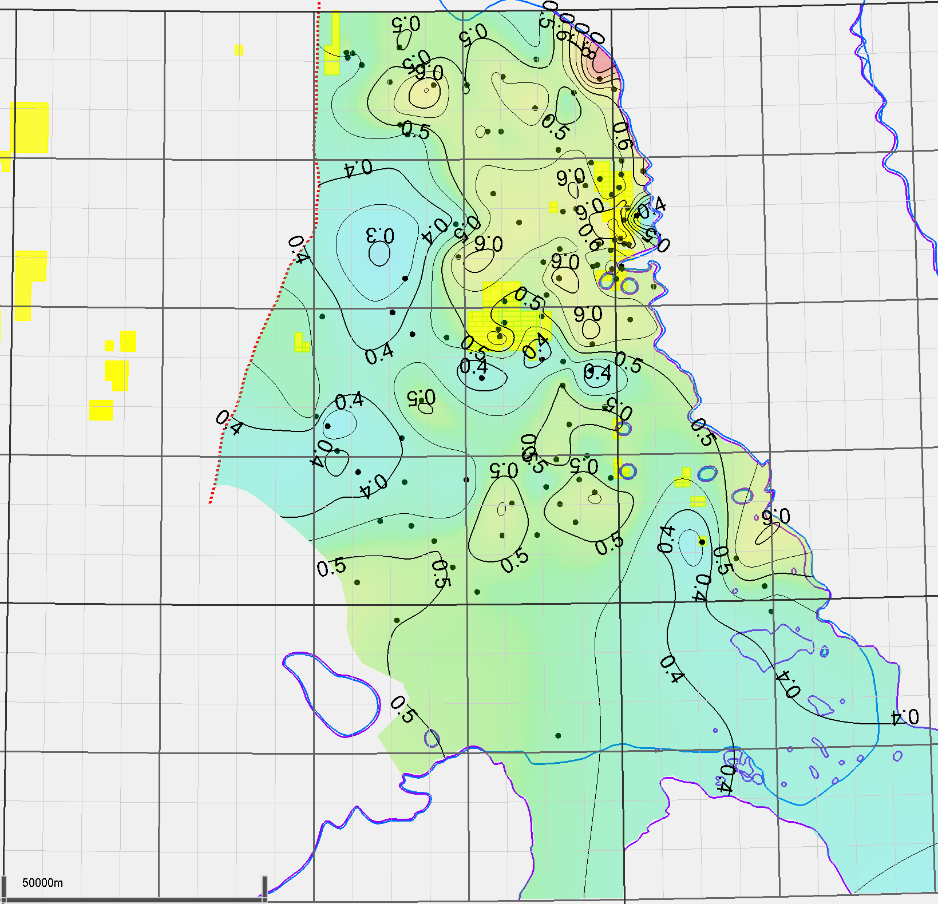
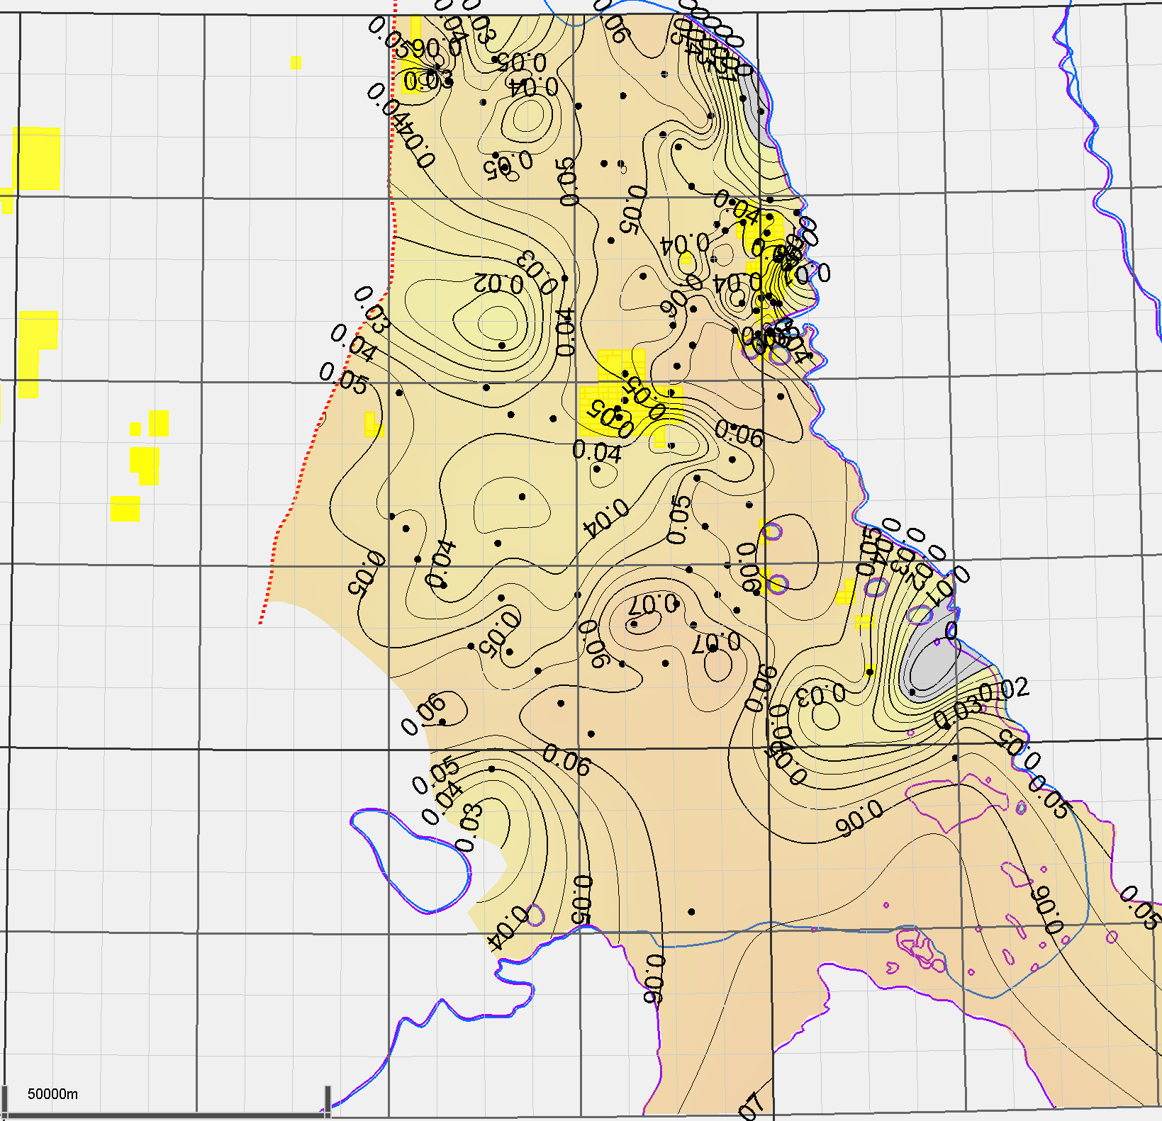
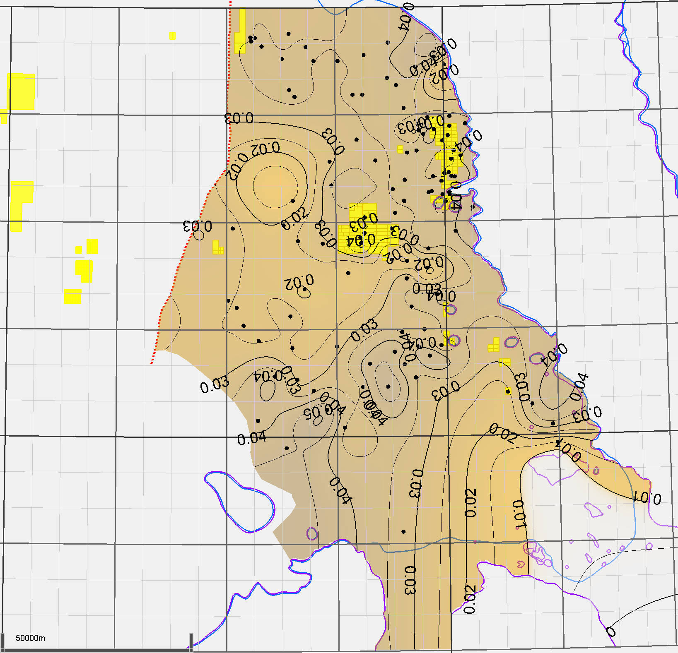
MOP Property Maps
200-d-052-L-094-O-08/00
Porosity
Quartz
Mineral
content
GR
φ
0.005 contour interval
0.05 contour interval
MUSKWA
Muskwa-
OP
OTTER
PARK
TOC
E-ZONE
EZone
MOP
MOP
LOP-MDC
LOP
KLUA
MDC
EVIE
Evie
KEG RIVER
0.005 contour interval
8

Slide 9
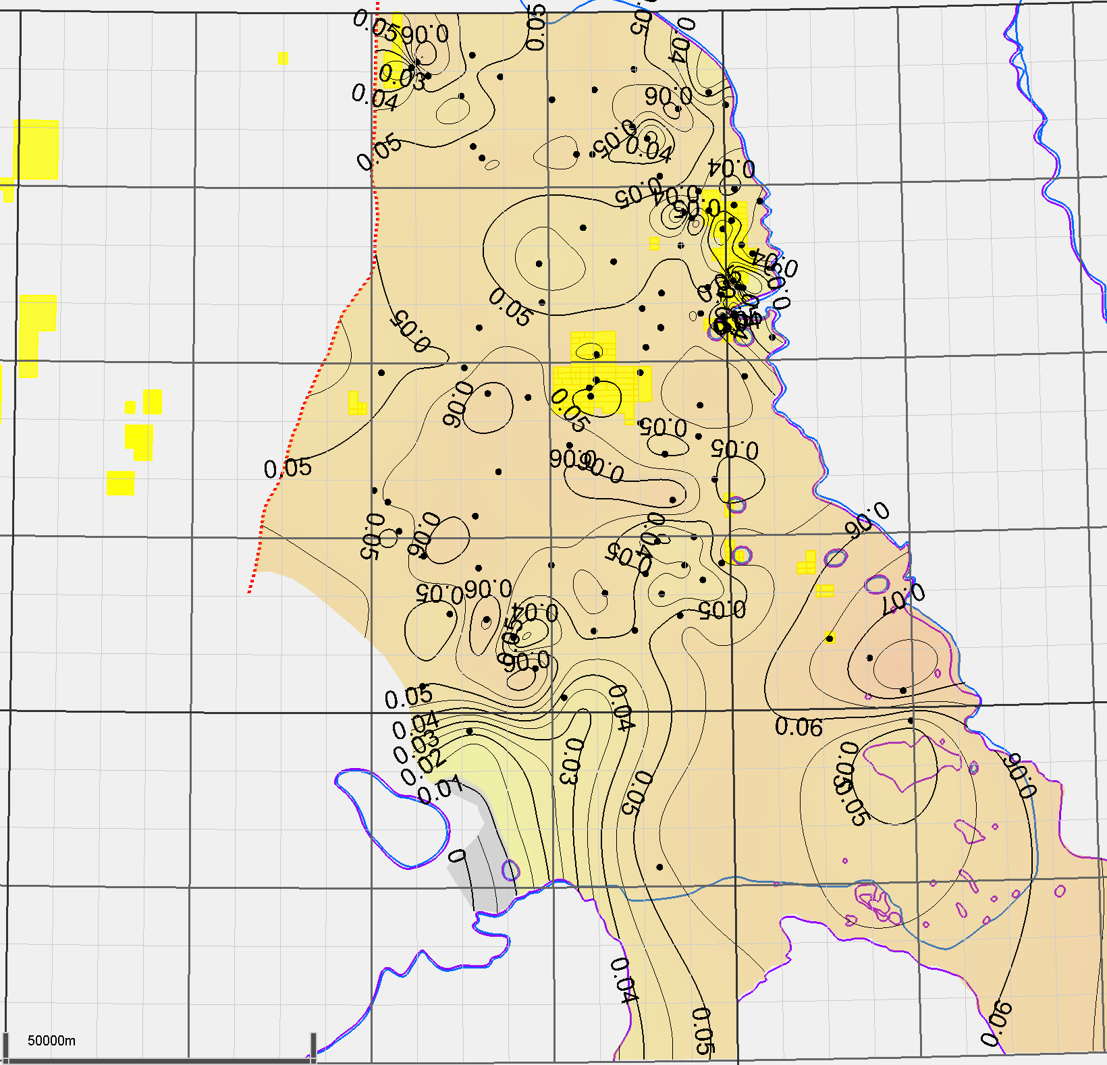
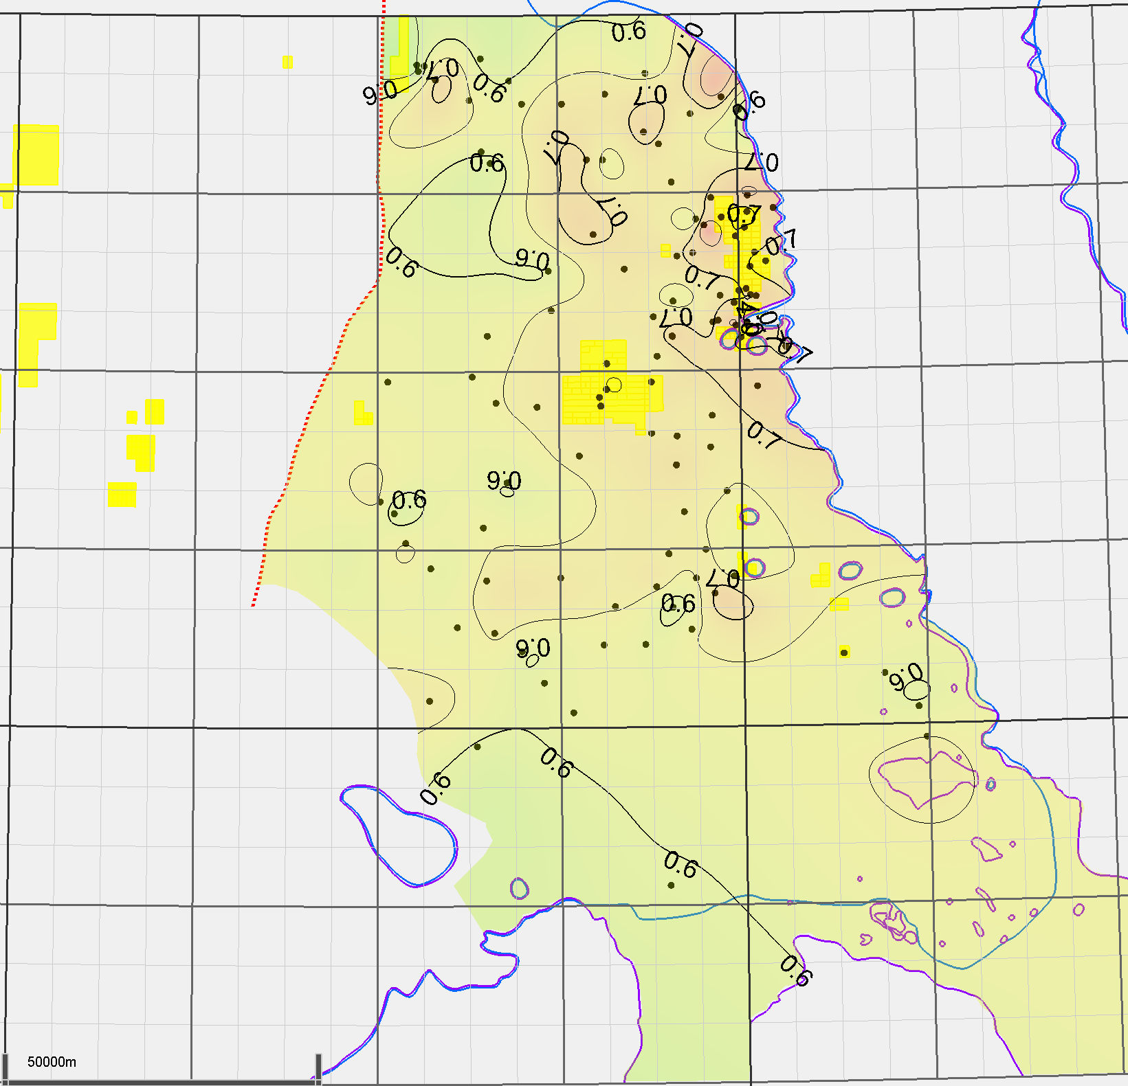
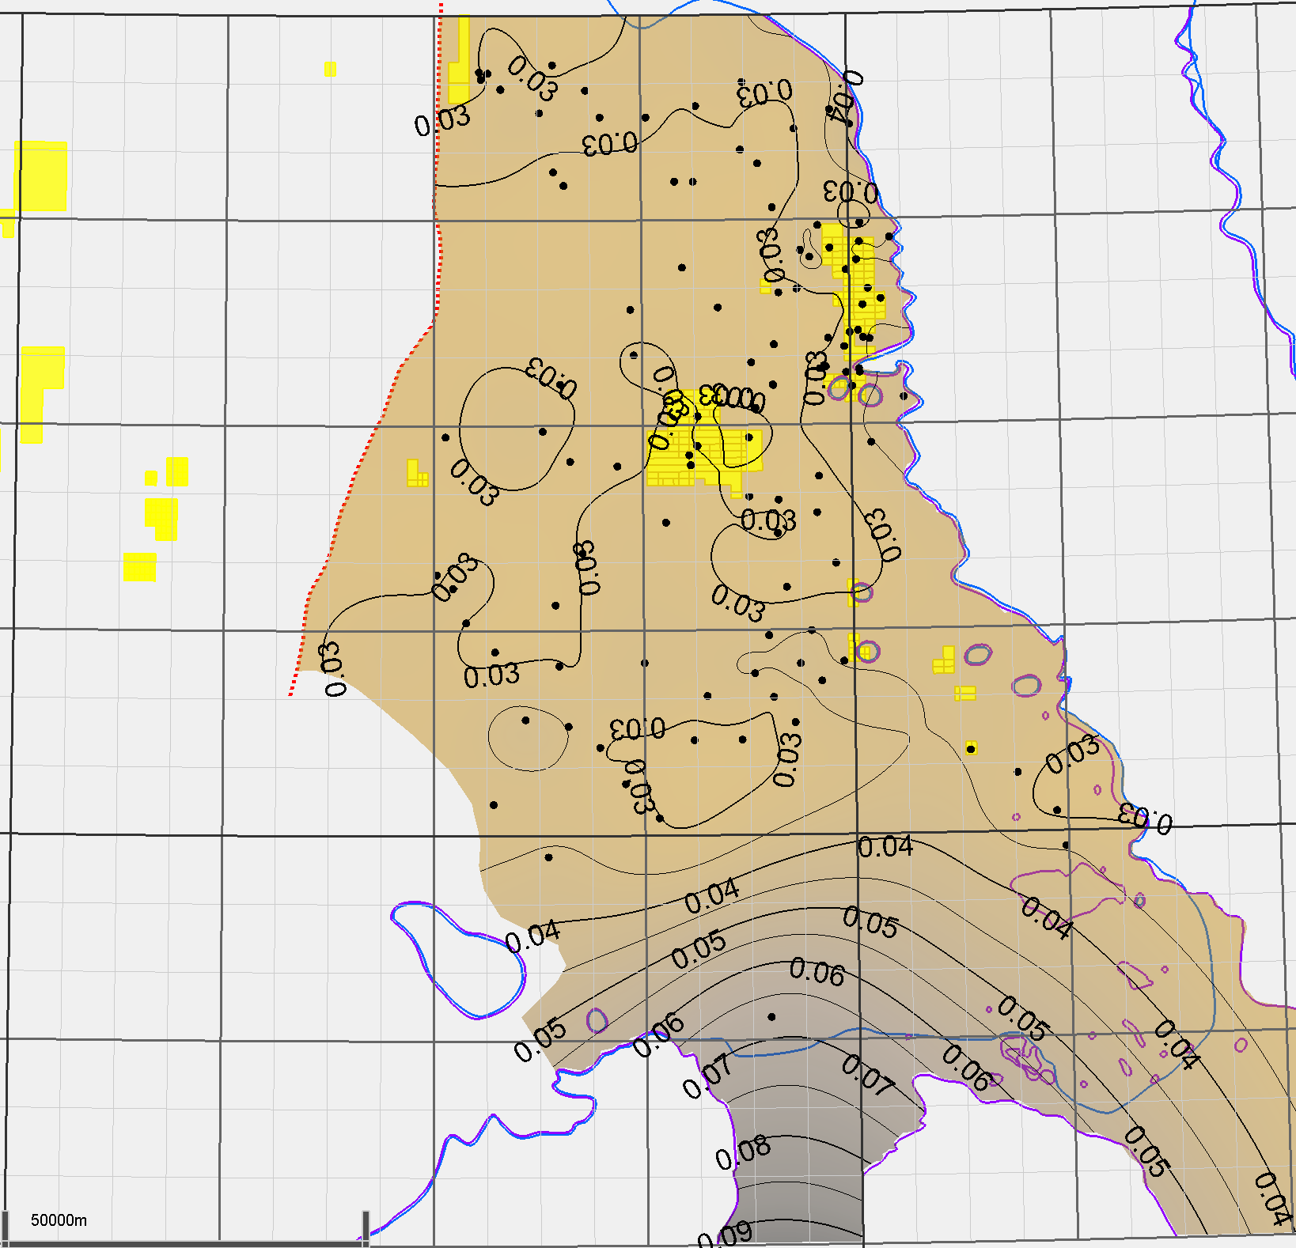
Muskwa Property Maps
200-d-052-L-094-O-08/00
Porosity
Quartz
Mineral
content
GR
φ
0.005 contour interval
0.05 contour interval
MUSKWA
Muskwa-
OP
OTTER
PARK
TOC
E-ZONE
EZone
MOP
MOP
LOP-MDC
LOP
KLUA
MDC
EVIE
Evie
KEG RIVER
0.005 contour interval
9

Slide 10
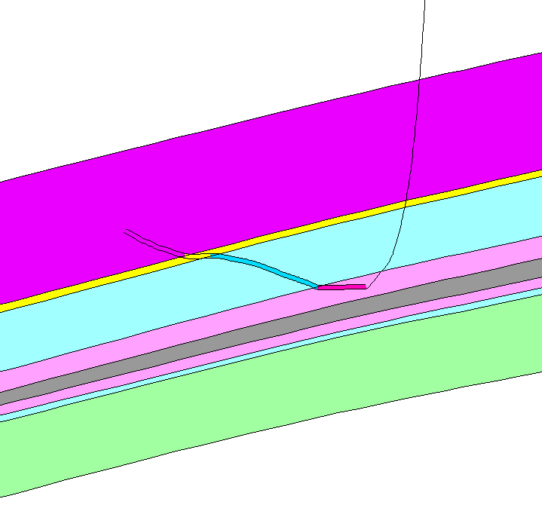
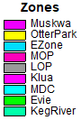
Landing Zone Analysis
200-d-052-L-094-O-08/00
Landing zone assignment
All wells are assigned a primary landing zone
In some cases, cross-cutting means this approach simplifies results
Mineral
content
GR
φ
MUSKWA
Muskwa-
OP
OTTER PARK
E-ZONE
EZone
MOP
MOP
LOP-MDC
LOP
KLUA
MDC
EVIE
Evie
KEG RIVER
10
Cutting through EZone typical of multi-zone wells

Slide 11
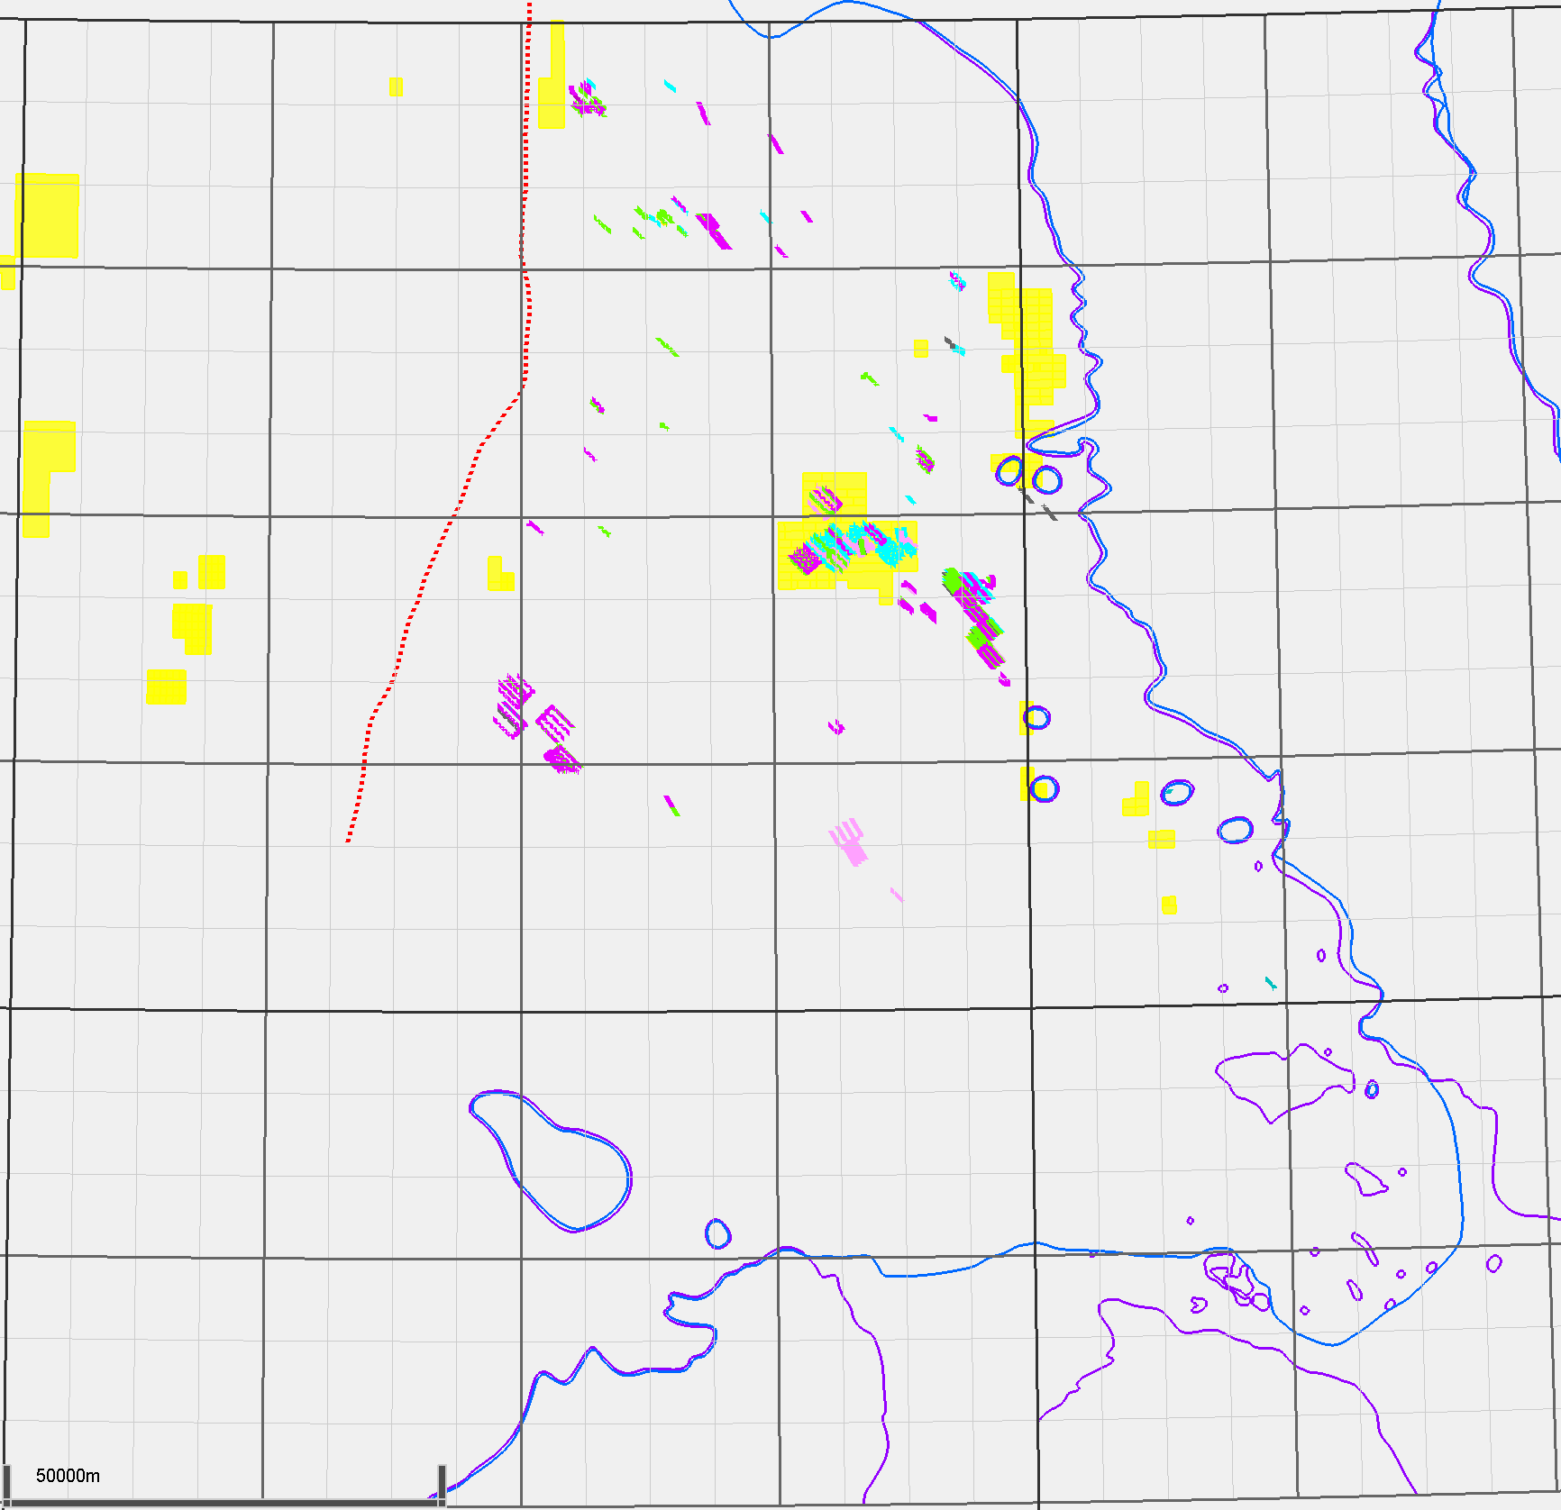
Landing Zone Analysis
200-d-052-L-094-O-08/00
NWT
Primary landing zones
OP - Muskwa: 91
EZone: 65
MOP: 34
LOP: 10
Klua: 1
MDC: 4
Evie: 77
Mineral
content
GR
φ
Maxhamish
Cordova Embayment
MUSKWA
Liard Basin
Tattoo
Muskwa-
OP
Ootla
Bovie Fault System
Gote
Etsho
OTTER PARK
E-ZONE
Komie
Kiwigana
Slave Point Reefs
EZone
MOP
MOP
LOP-MDC
LOP
KLUA
MDC
EVIE
Evie
Presqu’ile Reefs
KEG RIVER
11
Total of 282 horizontals landed in Horn River

Slide 12
Maxhamish/Tattoo
NWT
Maxhamish land rights
50% POU, 50% CNRL
Surface to base Evie
Maxhamish
Cordova Embayment
Liard Basin
Tattoo
Ootla
Bovie Fault System
Gote
Etsho
Komie
Kiwigana
Slave Point Reefs
Presqu’ile Reefs
12
Landing zone analysis by subregion

Slide 13
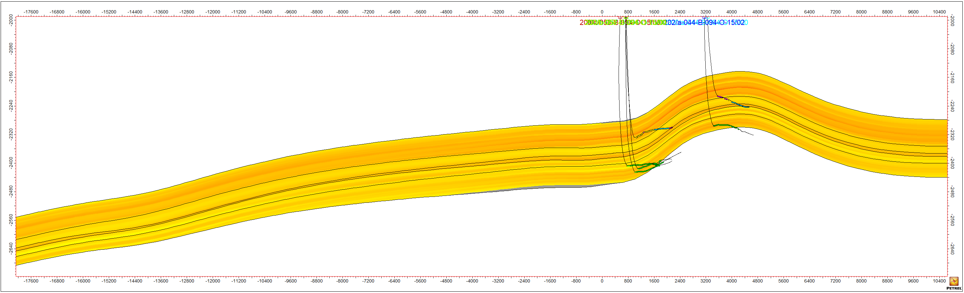
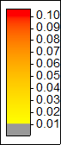
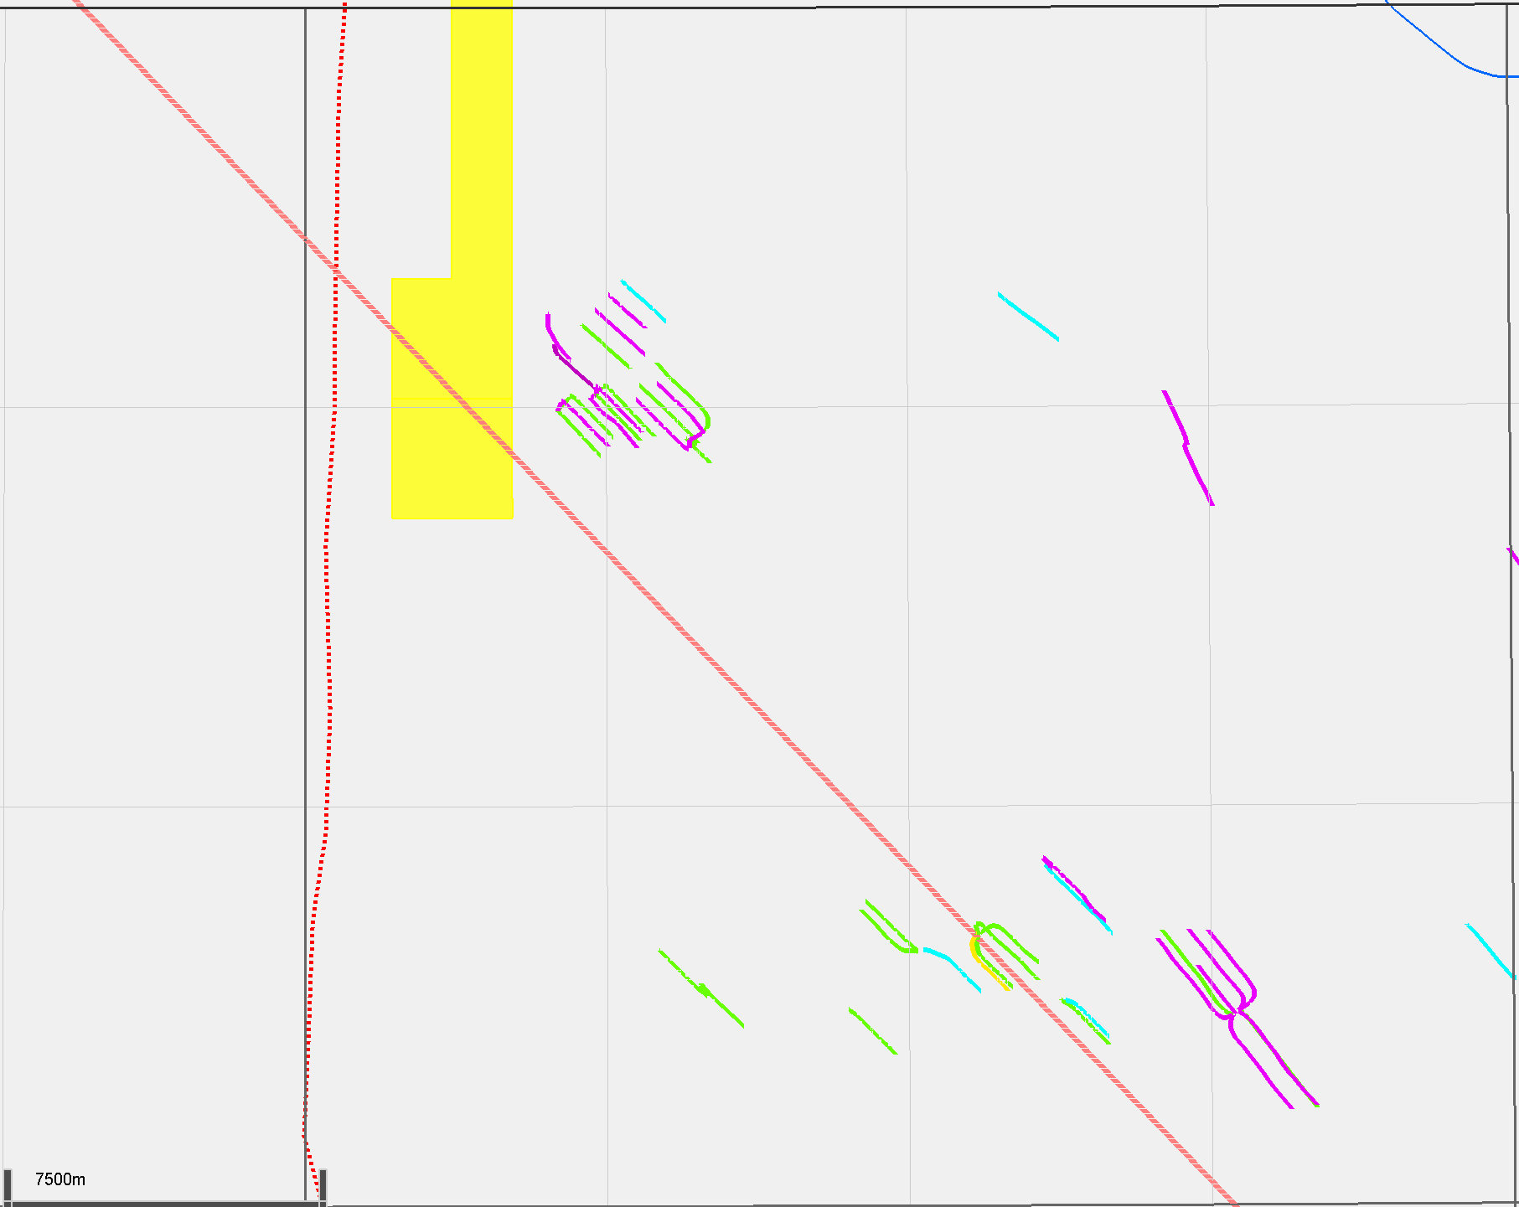
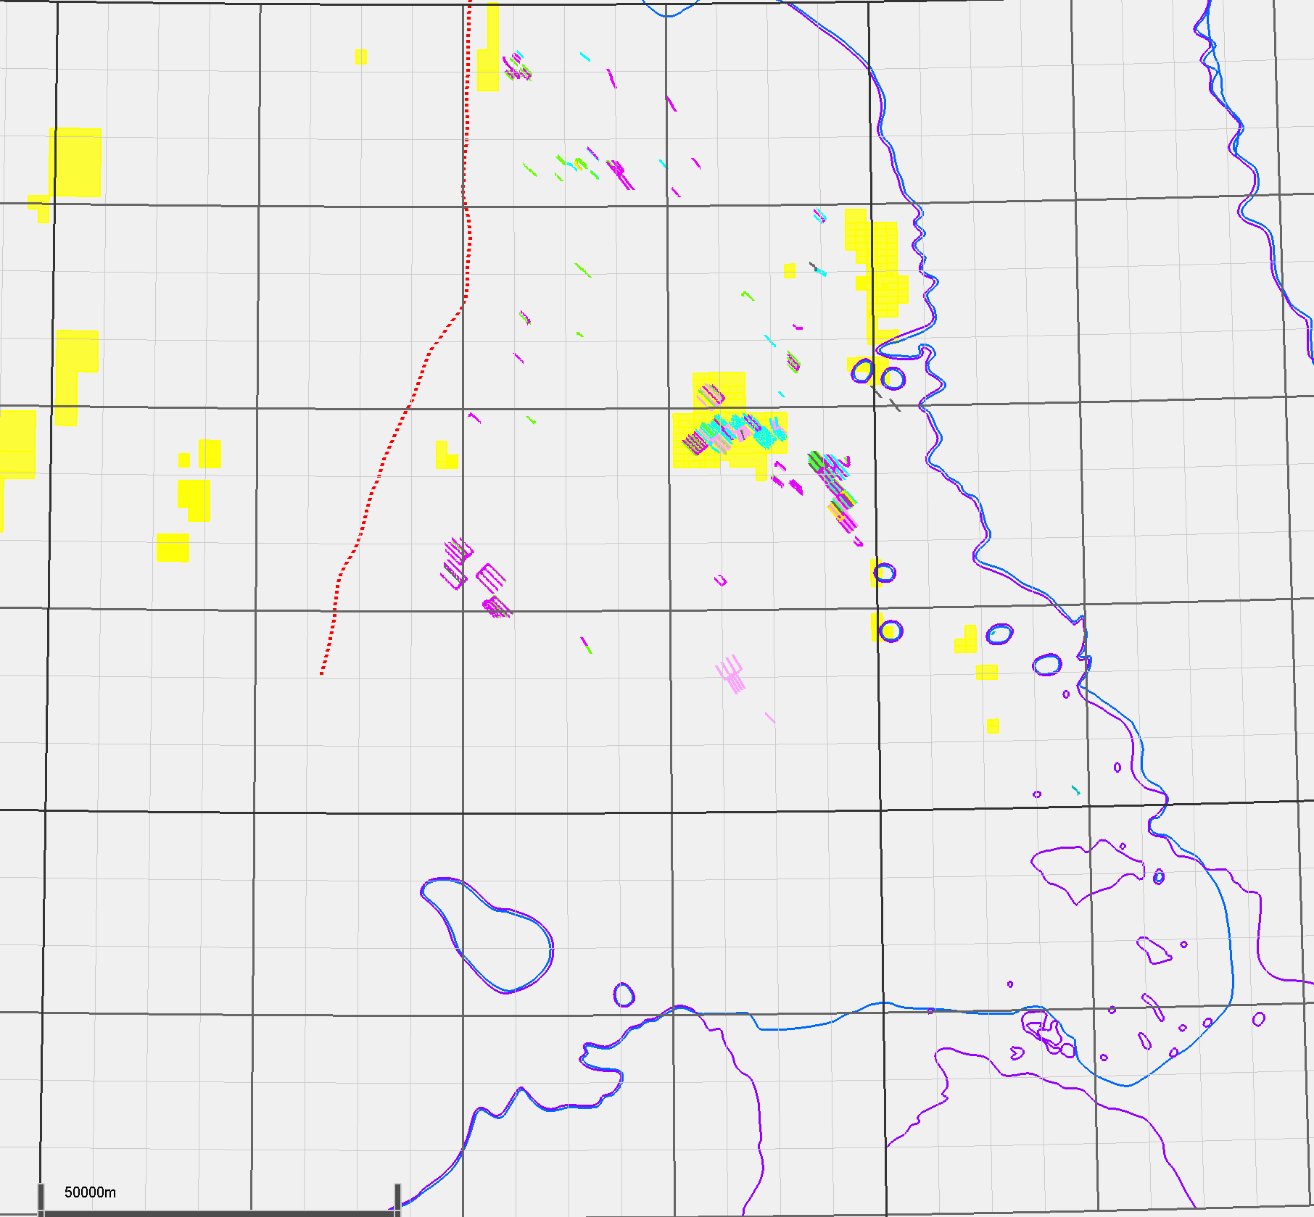
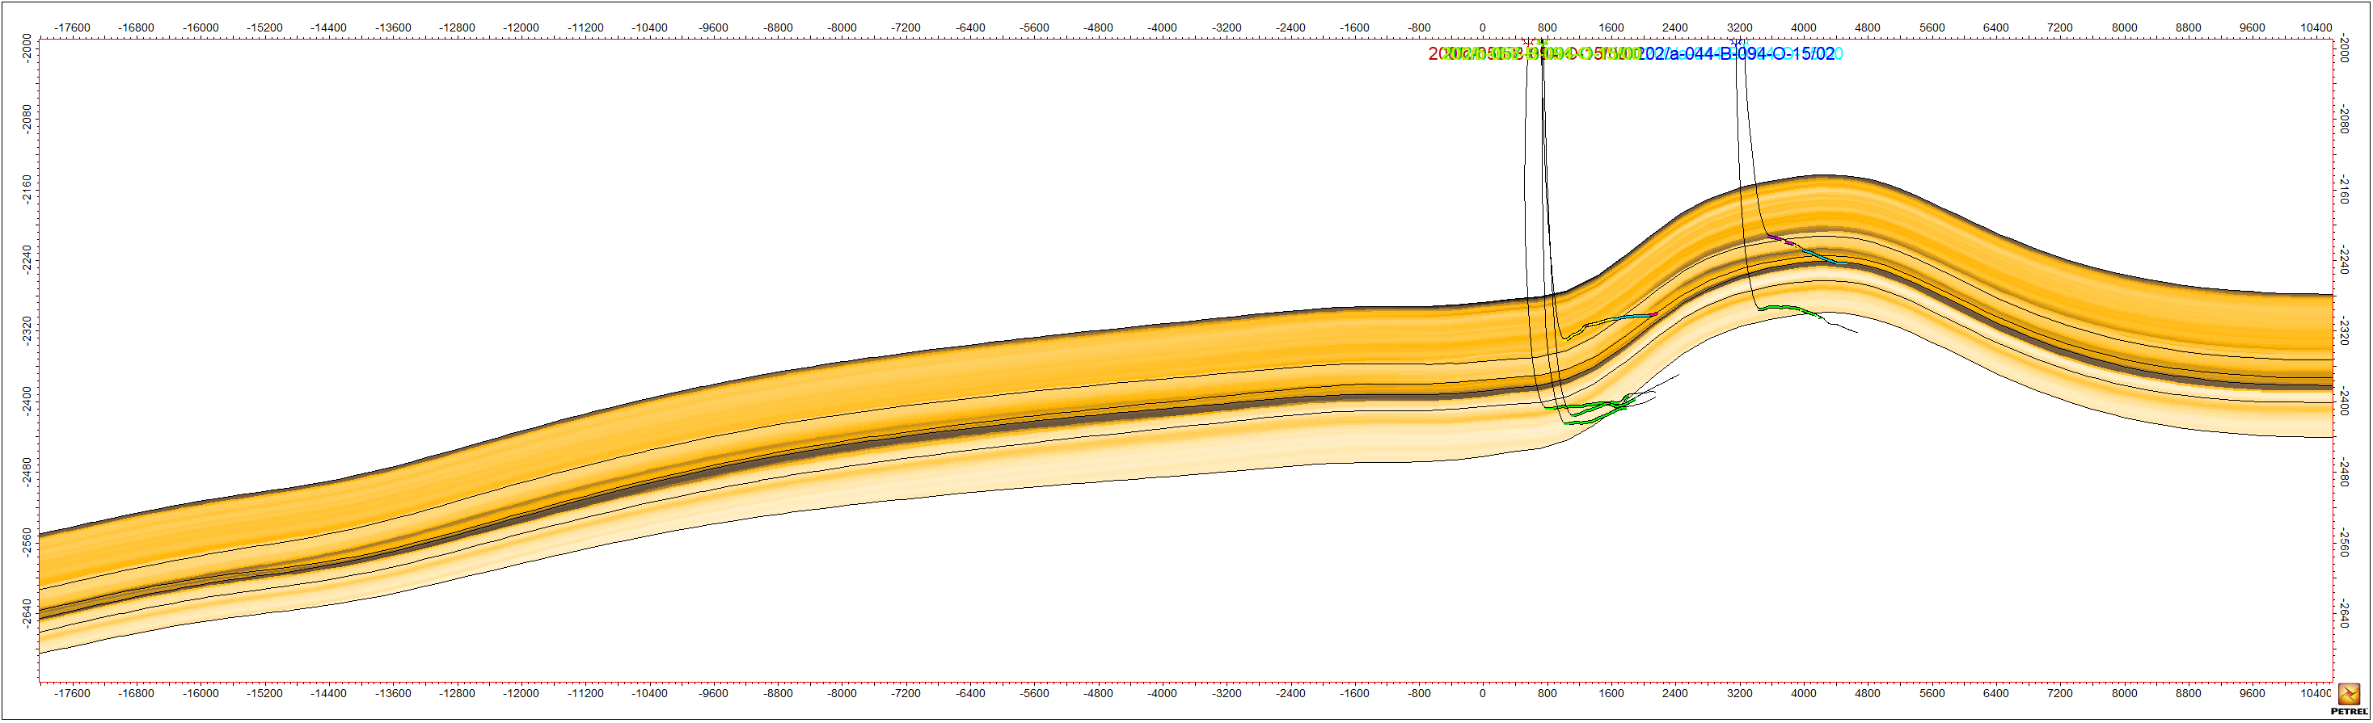
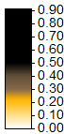
Maxhamish/Tattoo
Tattoo
Horizontals target Evie, Muskwa
A few wells move from Muskwa to EZone, MOP
Porosity
11x vertical exaggeration
MUSKWA
2008/2009/2011
MOP
EVIE
2008/2009
Tattoo
Maxhamish
Clay Volume
11x vertical exaggeration
MUSKWA
2008/2009/2011
MOP
EVIE
Tattoo
2008/2009
Tattoo
13
NW
This well geometry is rare
SE

Slide 14
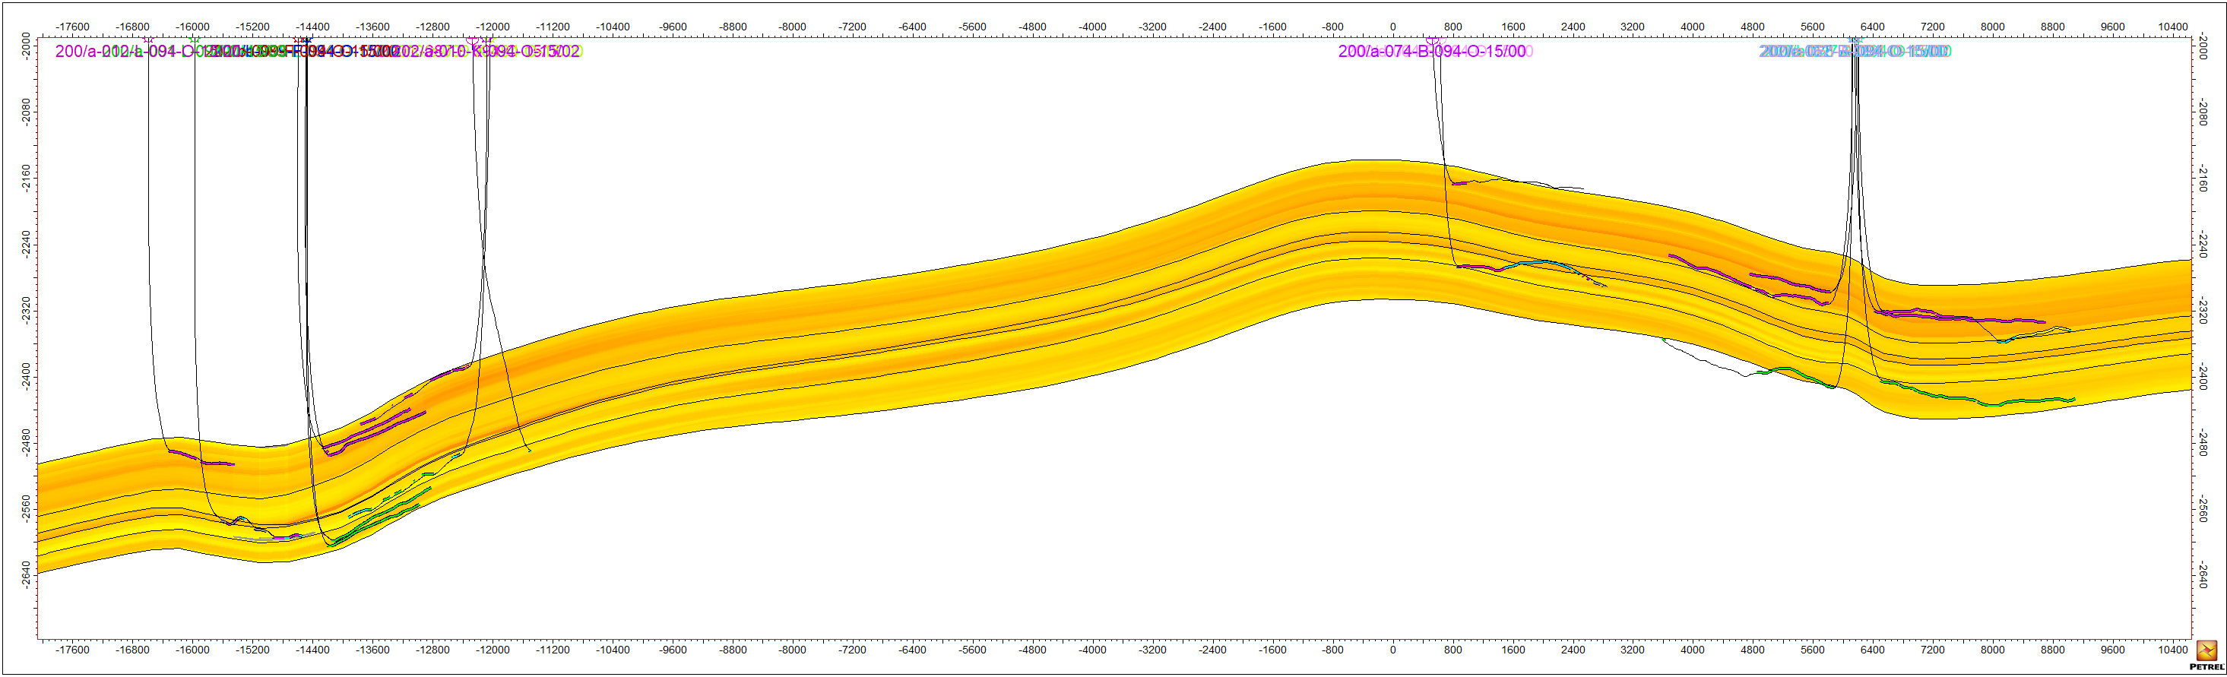
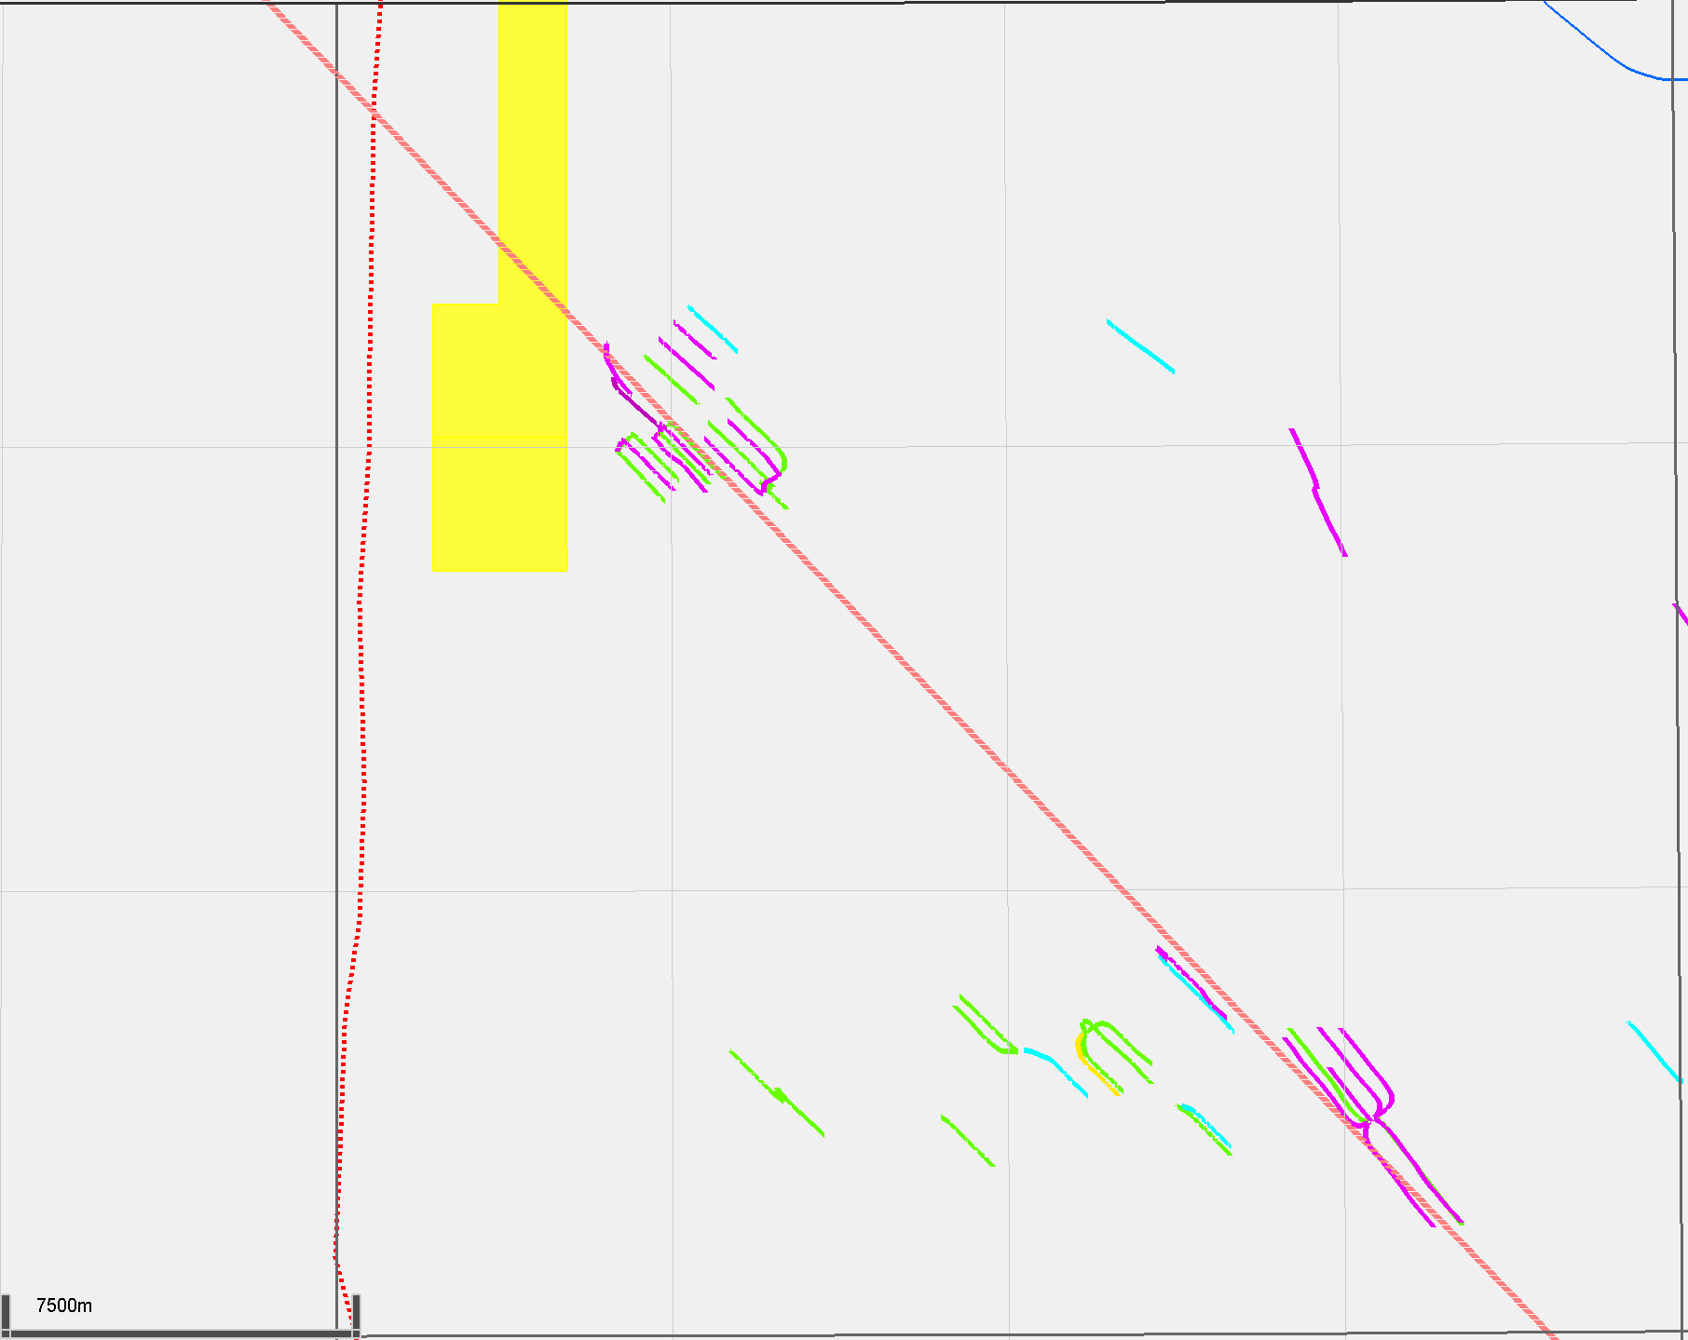
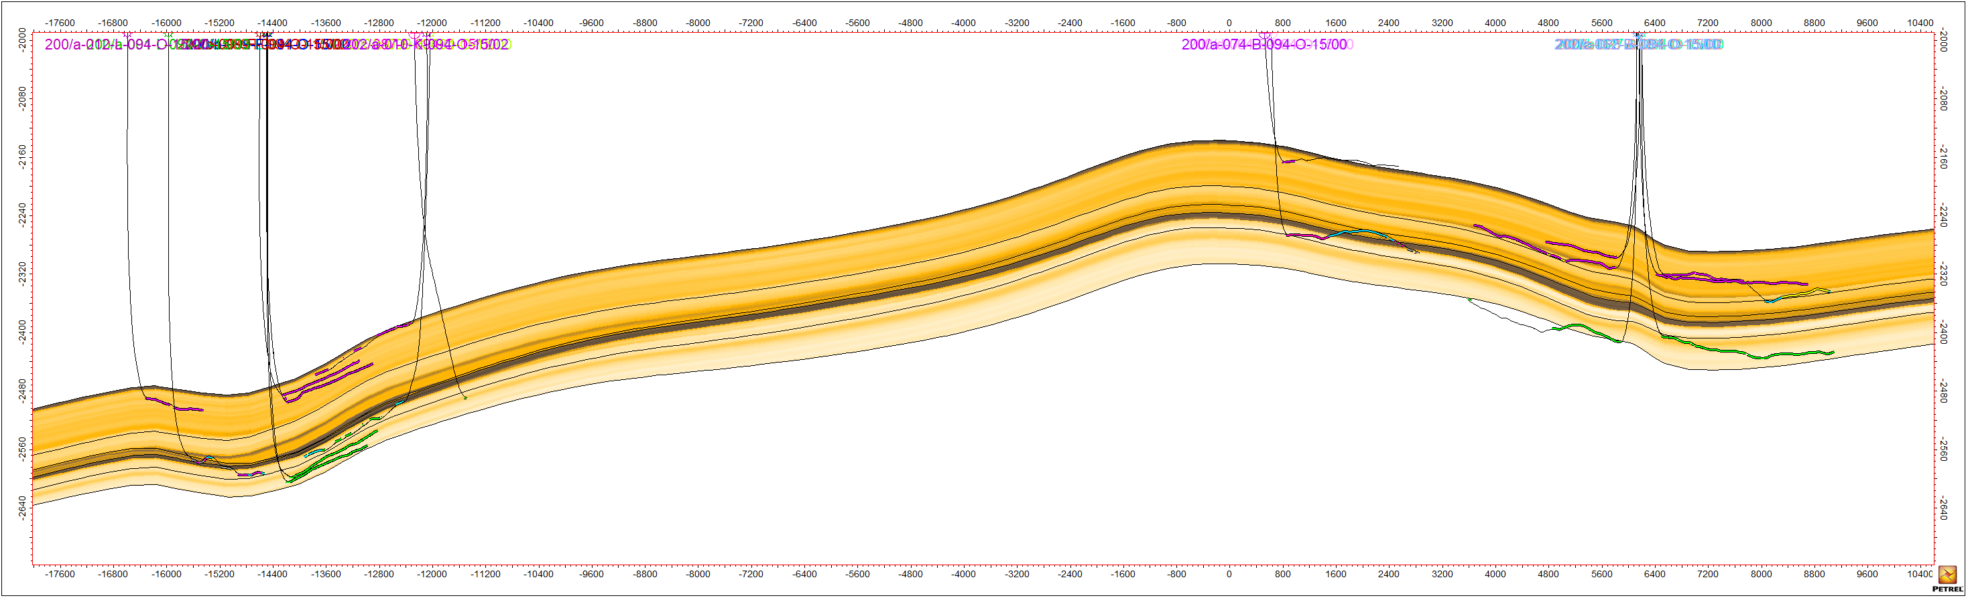
Maxhamish/Tattoo
Tattoo
Horizontals target Evie, Muskwa
Maxhamish
Horizontals target Evie, Muskwa
Porosity
11x vertical exaggeration
MUSKWA
2011
MOP
EVIE
2008/2010/2011
2009
Tattoo
2007
Maxhamish
Maxhamish
11x vertical exaggeration
Clay Volume
MUSKWA
2011
MOP
EVIE
2008/2010/2011
Tattoo
Tattoo
2007
2009
Maxhamish
14
NW
Parallel Evie and Muskwa horizontals dominate
SE

Slide 15
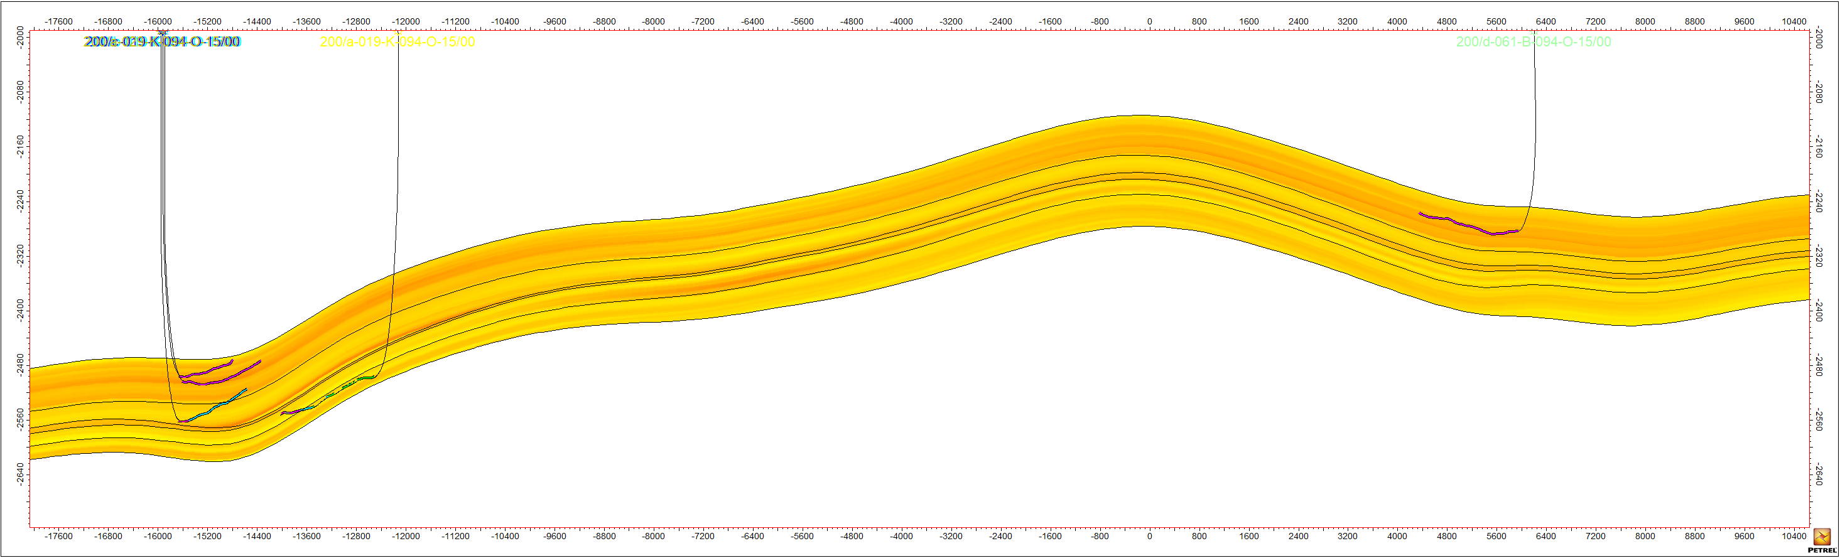
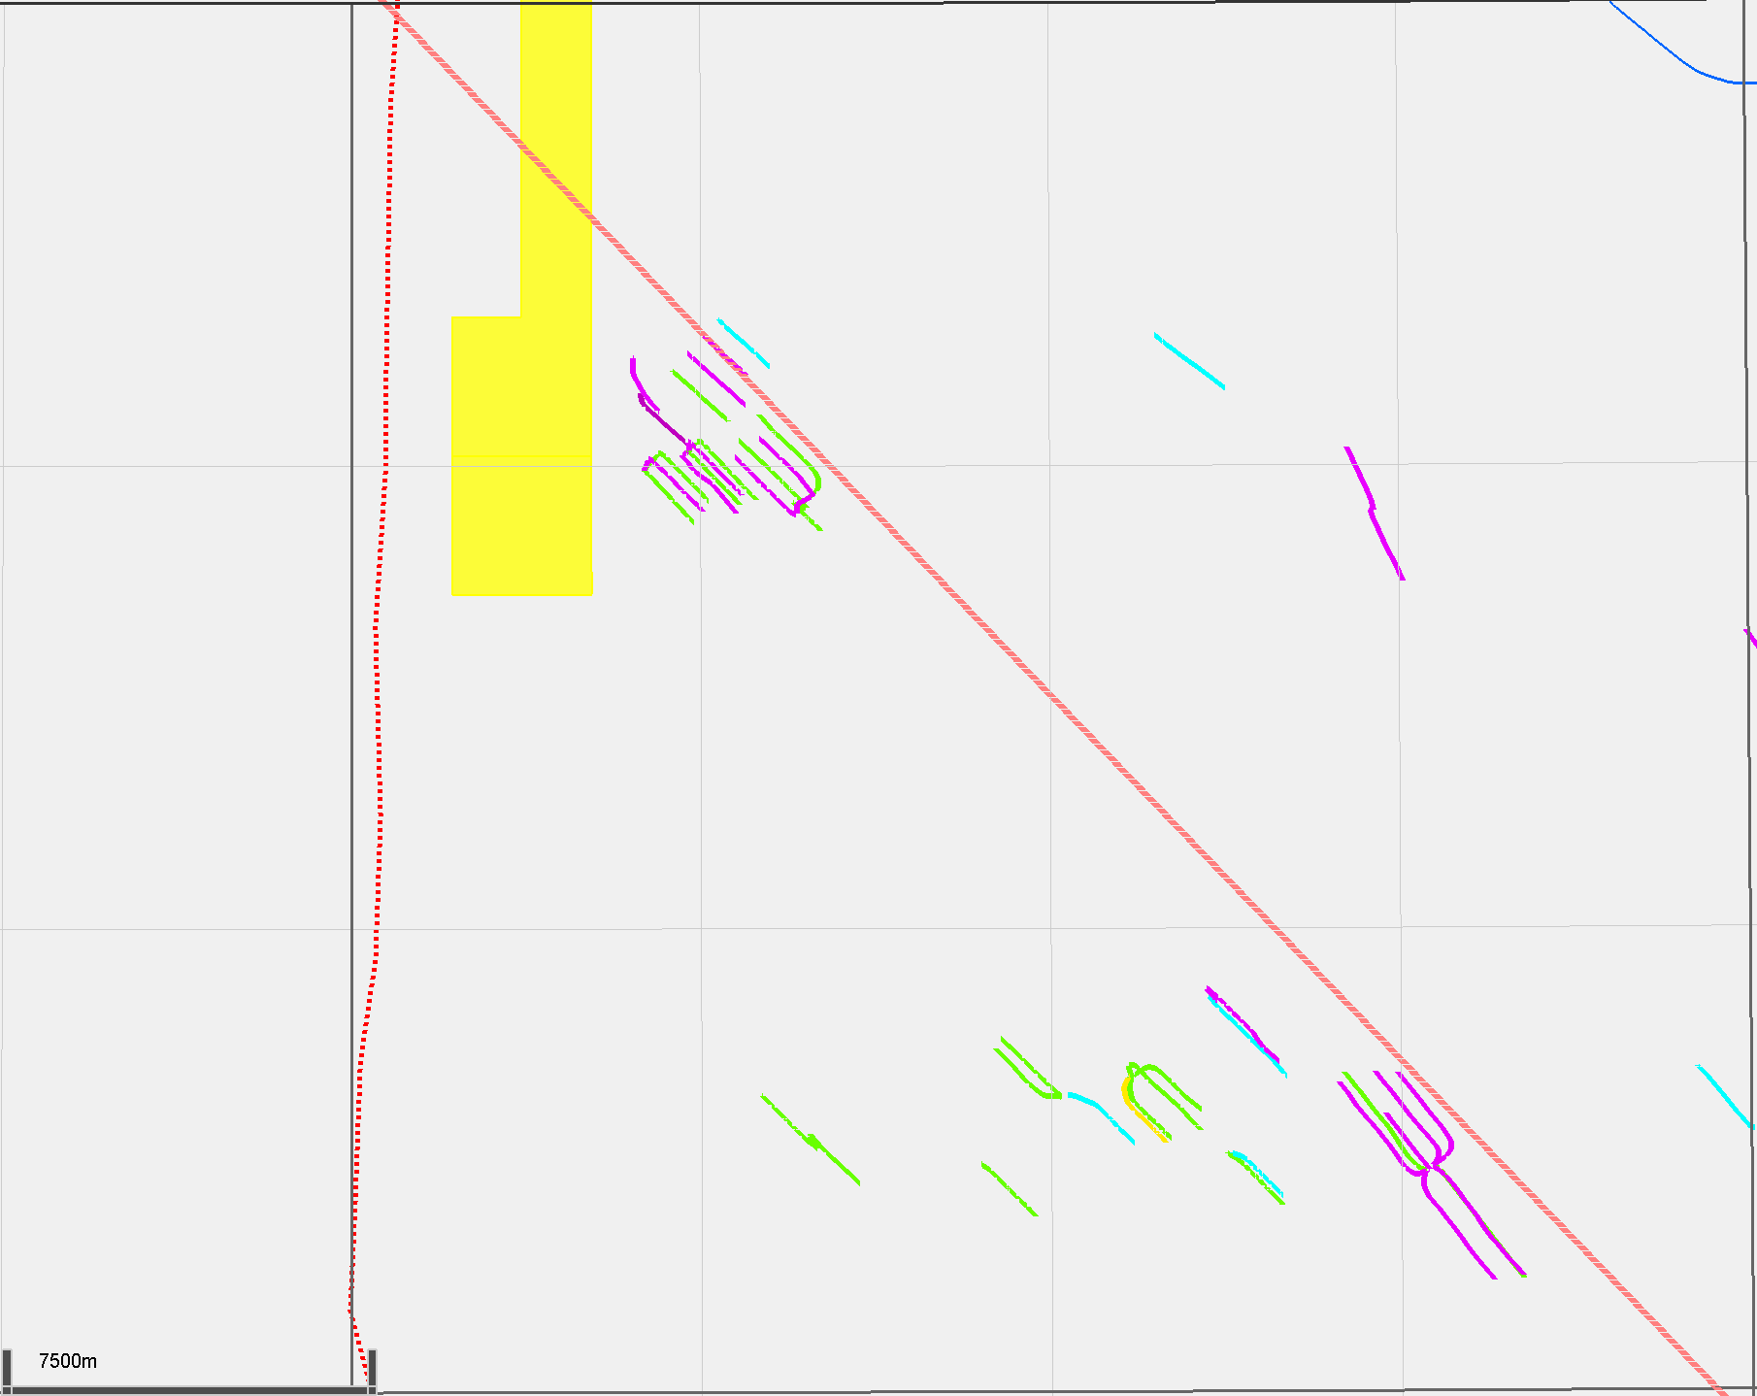
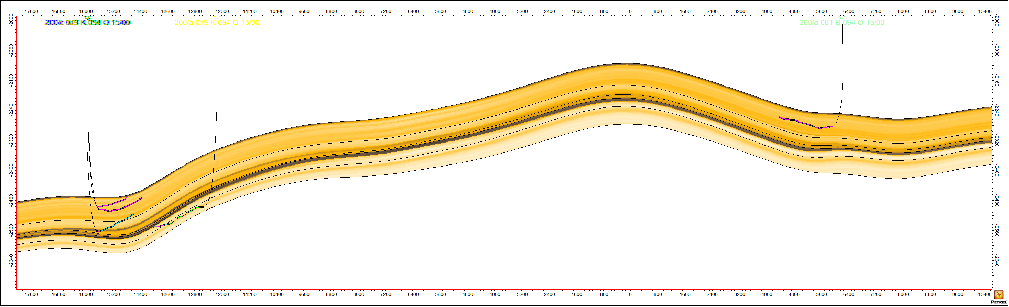
Maxhamish/Tattoo
Tattoo
Horizontals target Evie, Muskwa
Maxhamish
Can see one well cross-cutting EZone
Porosity
11x vertical exaggeration
MUSKWA
MOP
EVIE
2010
2009
Tattoo
2008
Maxhamish
Maxhamish
Clay Volume
11x vertical exaggeration
MUSKWA
MOP
EVIE
2010
Tattoo
Tattoo
2008
2009
Maxhamish
15
NW
EZone cross-cutting is present
SE

Slide 16
Ootla/Gote
NWT
Ootla land rights
Mixed
Approximately 60% POU, 40% CVE
Majority surface to base Evie/Keg River
Minority top surface to base Otter Park
Minority 100% POU
No horizontals
Gote land rights
60% POU, 40% CVE in East
50% POU, 50% CREW in West
Maxhamish
Cordova Embayment
Liard Basin
Tattoo
Ootla
Bovie Fault System
Gote
Etsho
Komie
Kiwigana
Slave Point Reefs
Presqu’ile Reefs
16
Ootla historically a lower priority region

Slide 17
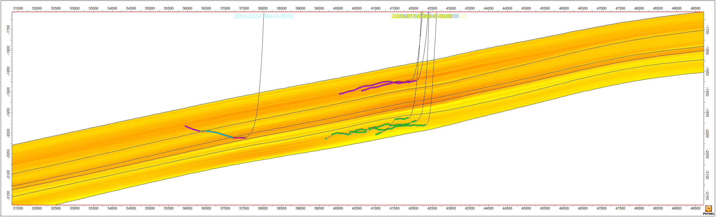
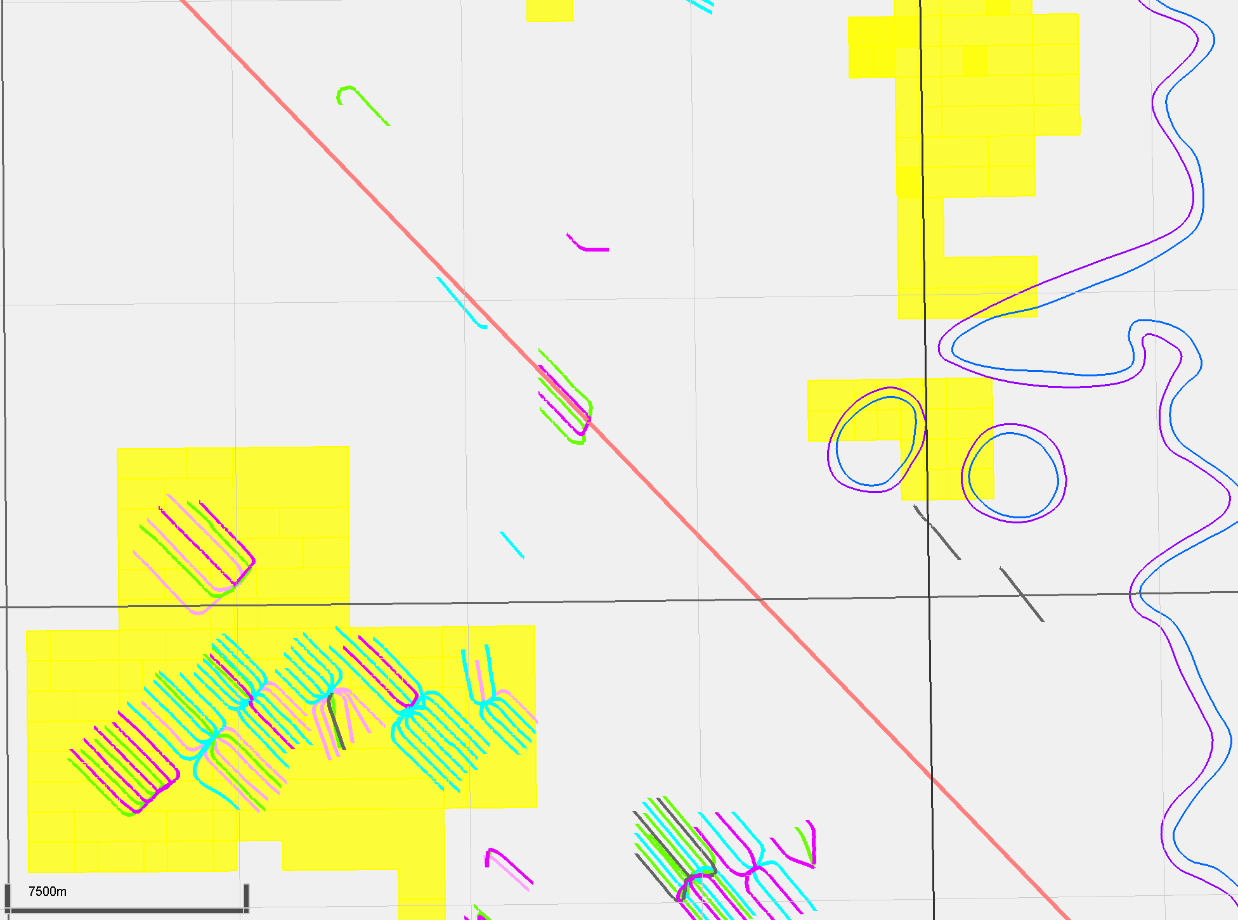
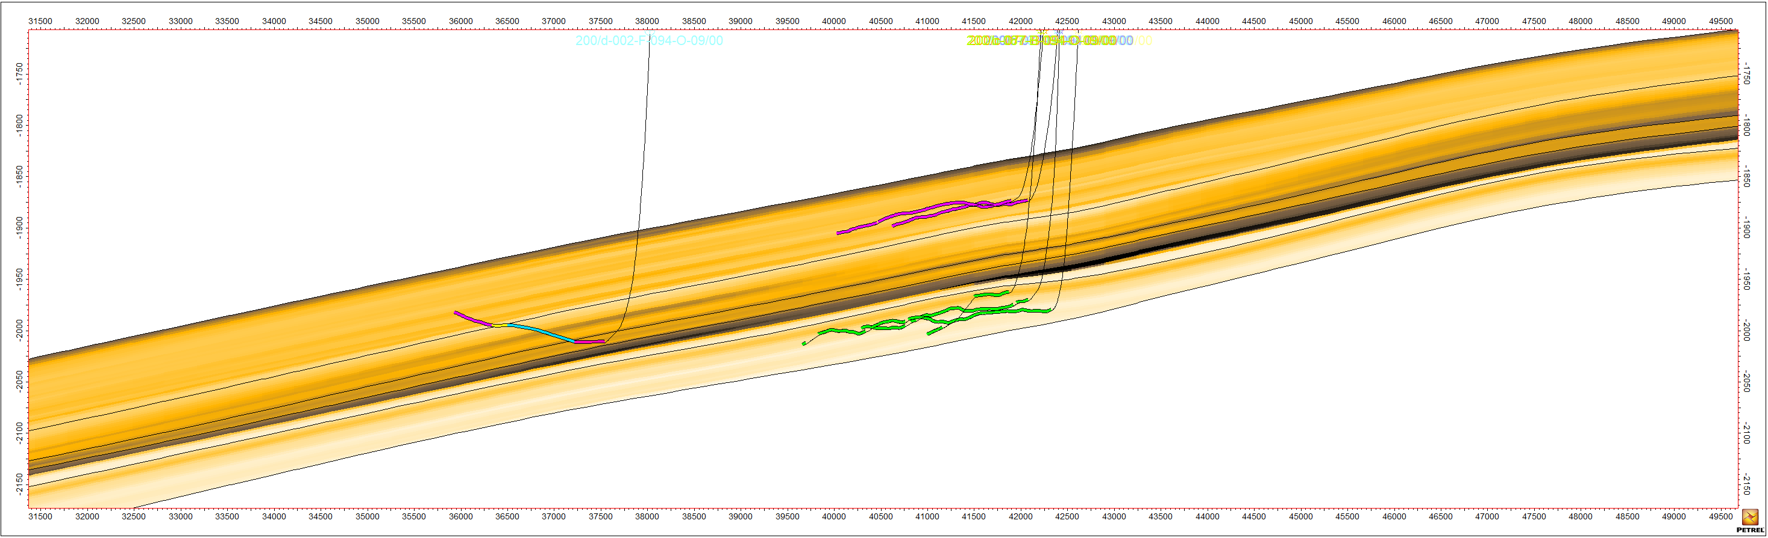
Ootla/Gote
Gote
Majority target Evie and Muskwa directly
One well cross-cuts EZone
Porosity
MUSKWA
E-ZONE
MOP
MDC-LOP
EVIE
2009/2010
2010
Gote
11x vertical exaggeration
Clay Volume
MUSKWA
E-ZONE
MOP
MDC-LOP
EVIE
Gote
2009/2010
2010
Gote
Etsho
11x vertical exaggeration
17
NW
Varying geometries in this area
SE

Slide 18
Etsho/Komie
NWT
Etsho land rights
50% POU, 50% OVV
Surface to base Evie
Minority 100% POU
Maxhamish
Cordova Embayment
Liard Basin
Tattoo
Ootla
Bovie Fault System
Gote
Etsho
Komie
Kiwigana
Slave Point Reefs
Presqu’ile Reefs
18
All current Paramount pads are within Etsho

Slide 19
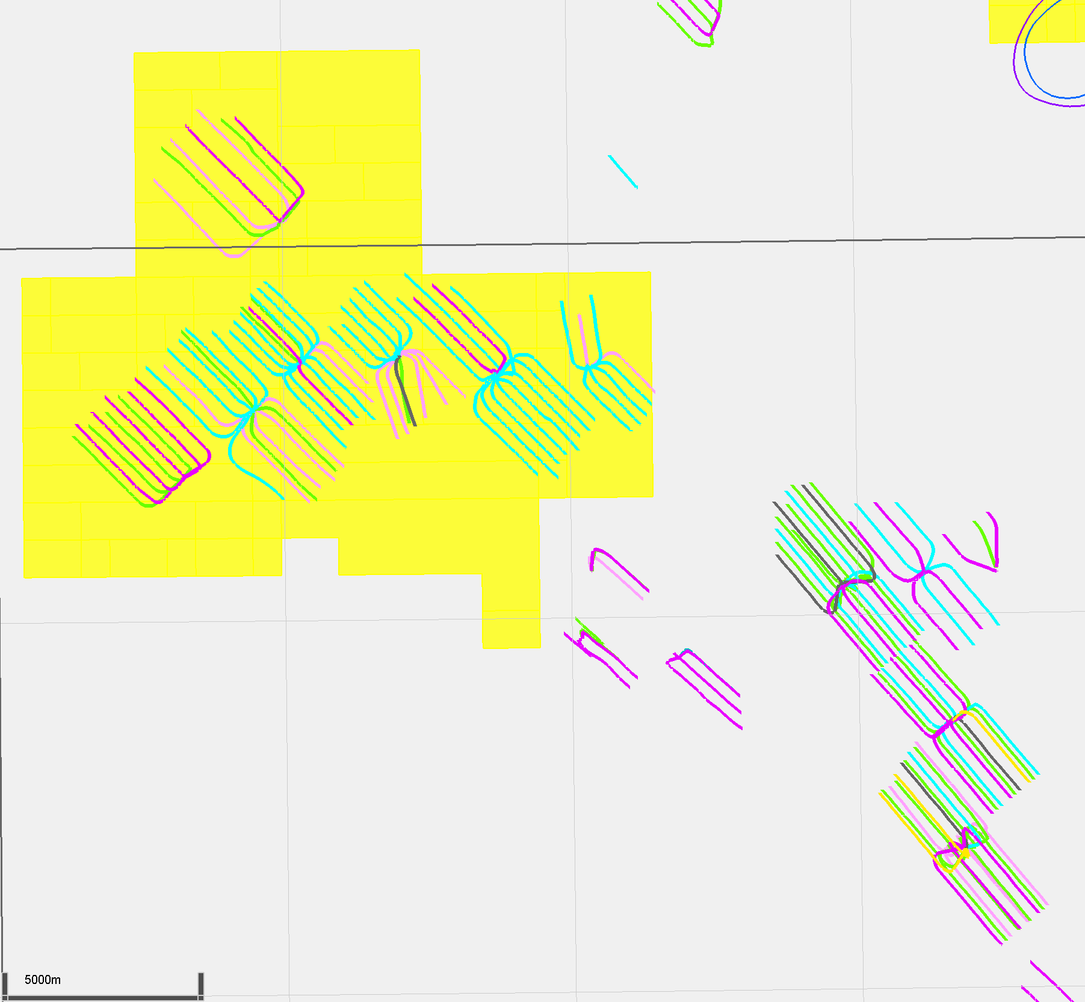
Etsho/Komie
Etsho pads
Seven POU pads in Etsho area
52L drilled but uncompleted, all others are producers
Mix of landing zones, with majority targeting EZone/MOP
34L pad focuses on Muskwa and Evie
Komie
Mix of landing zones
Gote
D1D
70K
76K
70J
63K
52L
Etsho
34L
Komie
19
52-L Pad is drilled but uncompleted

Slide 20
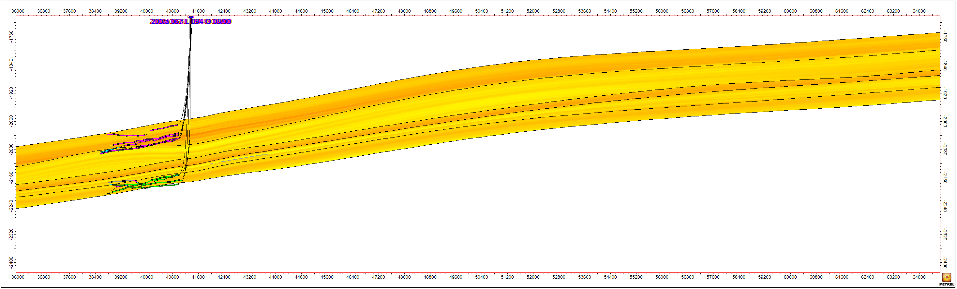
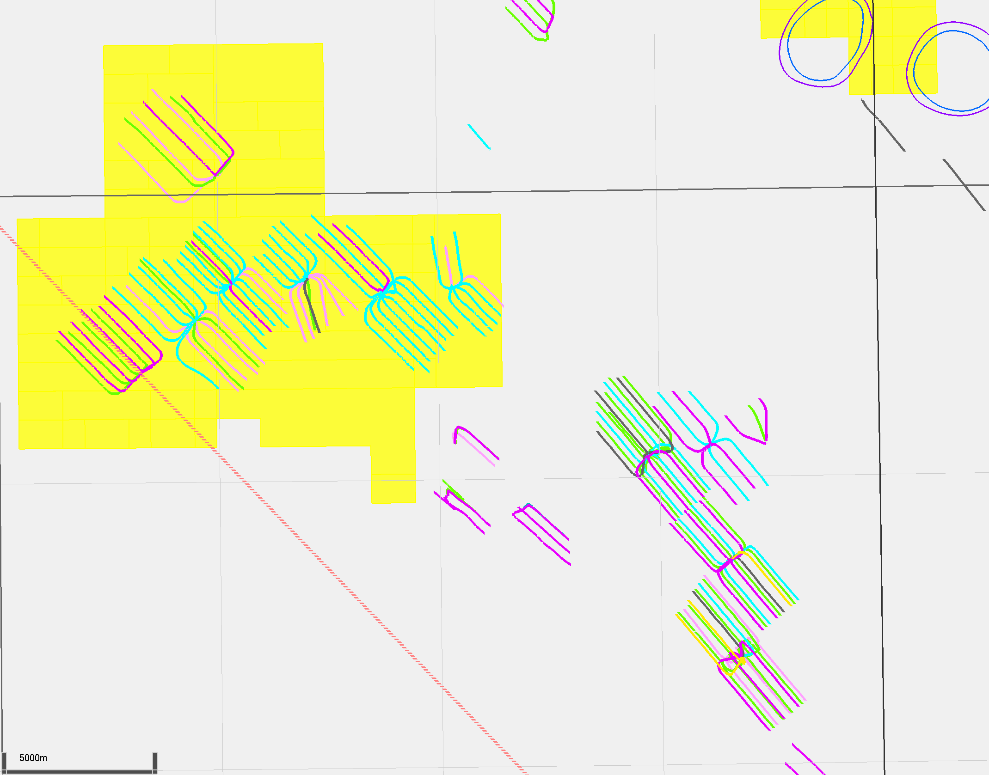
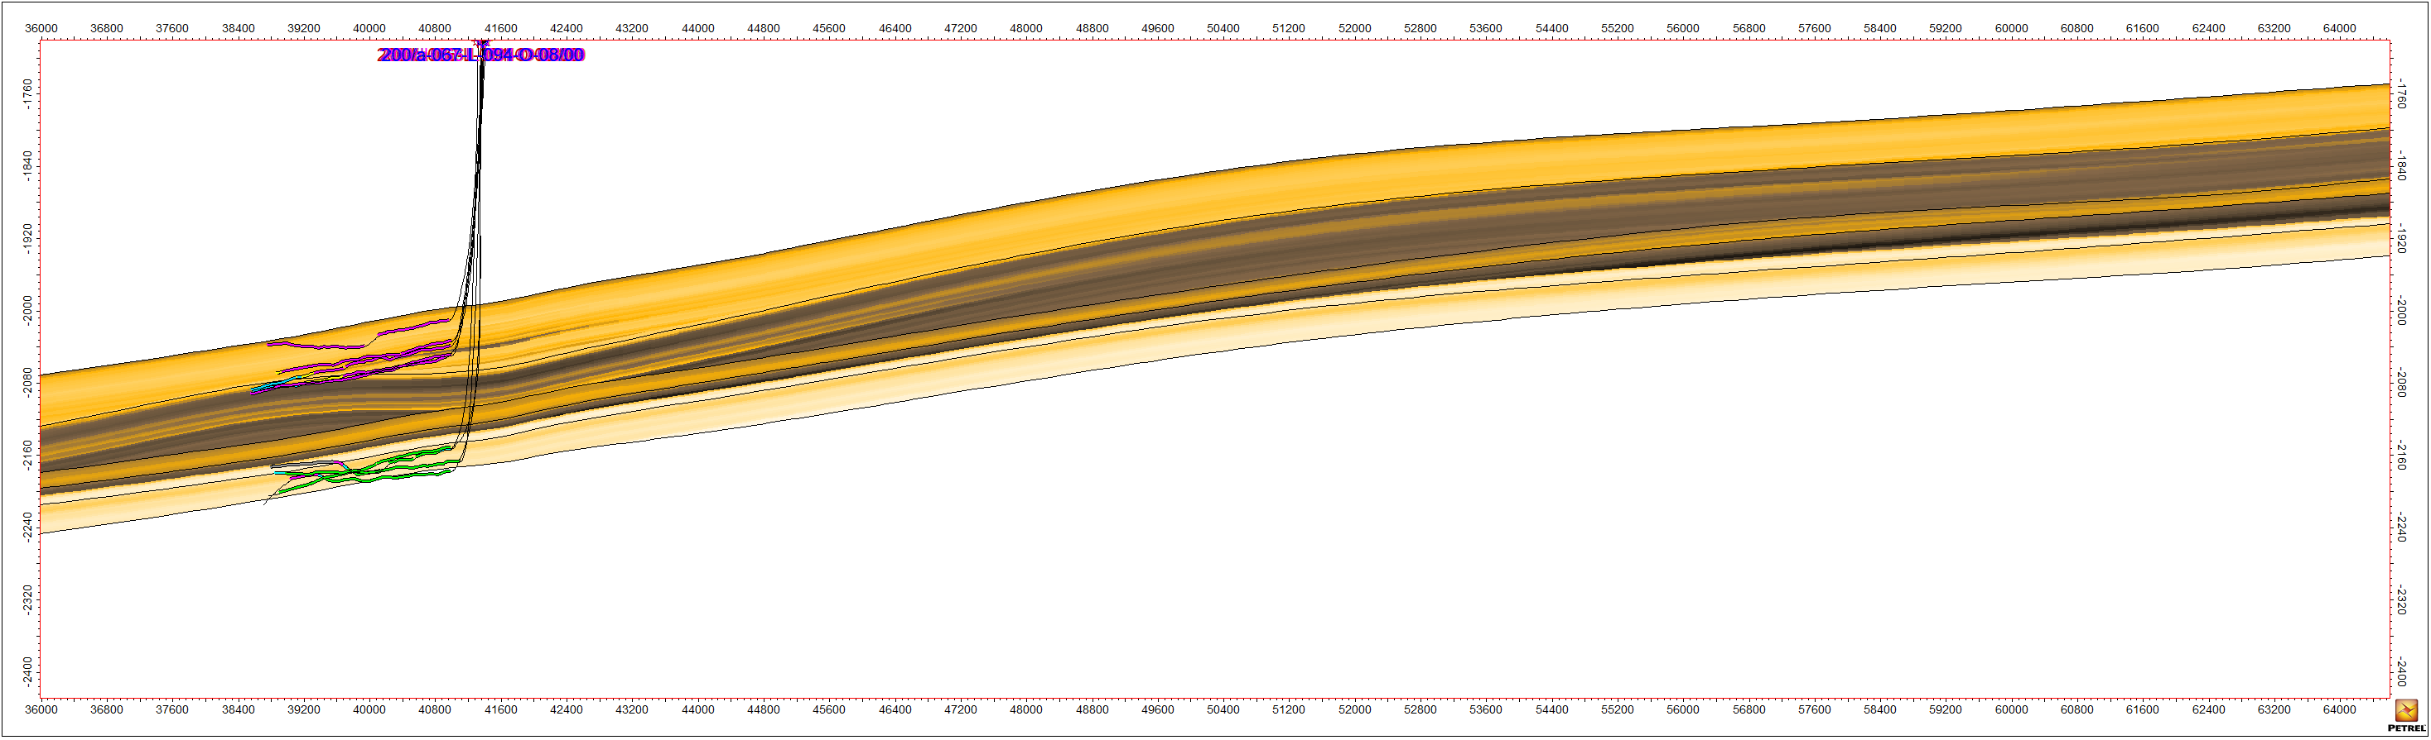
Etsho/Komie
34L
Targets Muskwa and Evie
Generally flat
Porosity
MUSKWA
E-ZONE
MOP
MDC-LOP
EVIE
34L
2010
Etsho
11x vertical exaggeration
Clay Volume
MUSKWA
D1D
E-ZONE
MOP
MDC-LOP
76K
70J
EVIE
70K
63K
52L
34L
Etsho
34L
2010
Etsho
11x vertical exaggeration
Komie
20
NW
No MOP/Ezone landings in 34L
SE

Slide 21
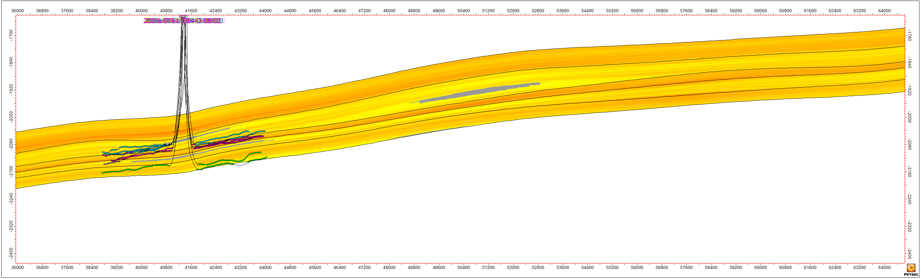
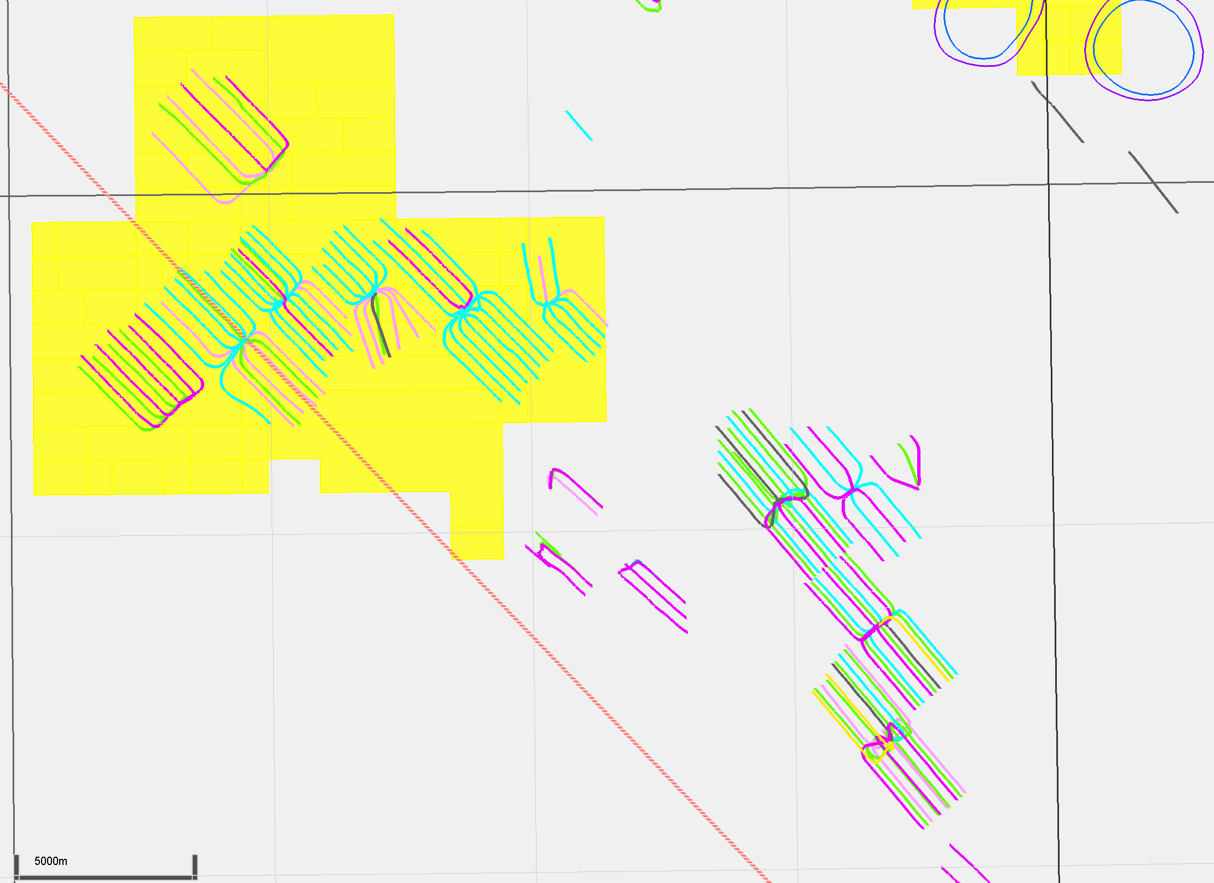
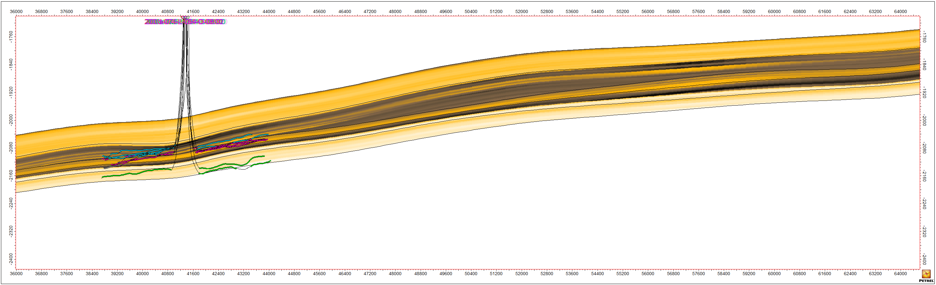
Etsho/Komie
52L
Uncompleted
Targets MOP/EZone, with some Evie wells
Porosity
MUSKWA
E-ZONE
MOP
MDC-LOP
EVIE
52L
2009
Etsho
11x vertical exaggeration
Clay Volume
MUSKWA
D1D
E-ZONE
MOP
MDC-LOP
70J
EVIE
63K
76K
70K
52L
34L
Etsho
52L
2009
Etsho
11x vertical exaggeration
Komie
21
NW
Biased towards MOP/EZone
SE

Slide 22
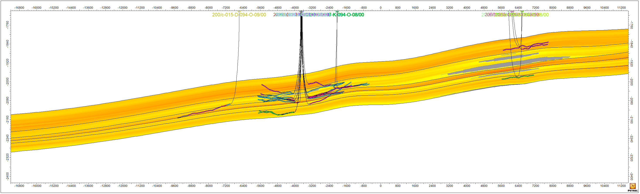
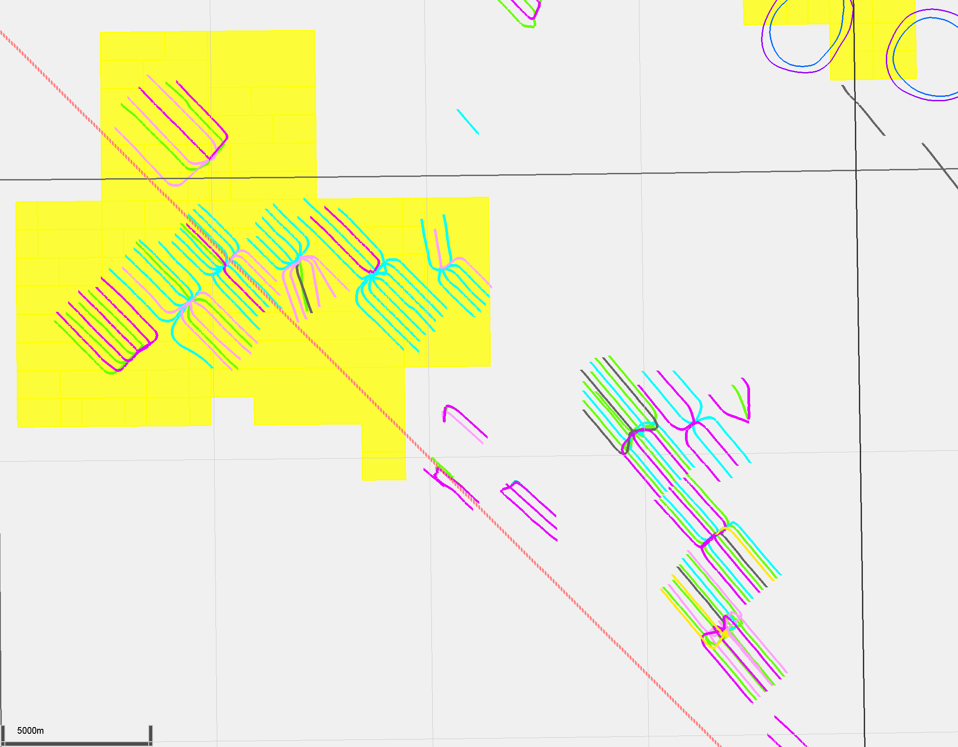
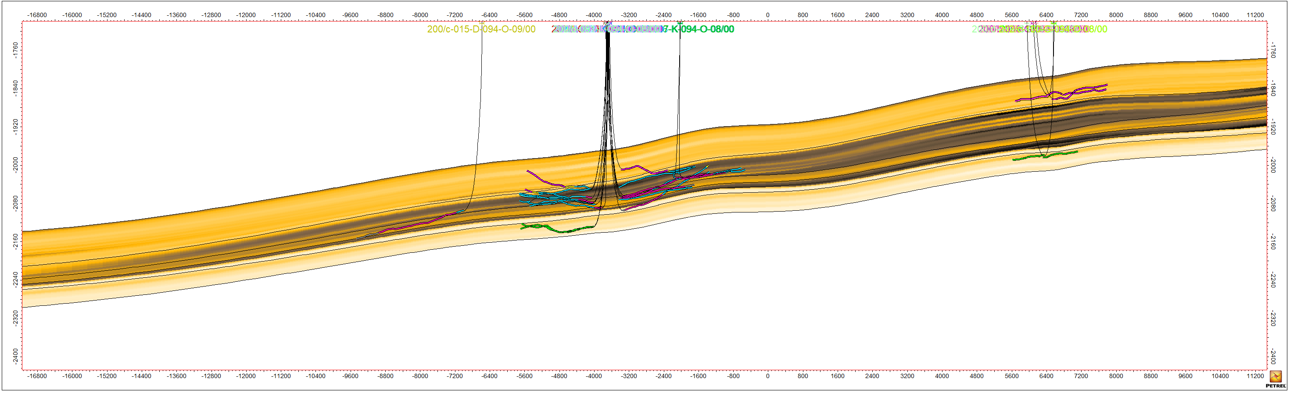
Etsho/Komie
70K
Targets MOP and EZone
This is the pad most similar to 52L
Porosity
MUSKWA
E-ZONE
MOP
MDC-LOP
EVIE
2007/2008
Komie
D1D
70K
2010
2008
Etsho
11x vertical exaggeration
Clay Volume
D1D
MUSKWA
E-ZONE
MOP
76K
70J
MDC-LOP
70K
63K
EVIE
52L
34L
Etsho
2007/2008
Komie
D1D
70K
2010
2008
Etsho
Komie
11x vertical exaggeration
22
NW
Analogue for 52L; wells have greater inclination
SE

Slide 23
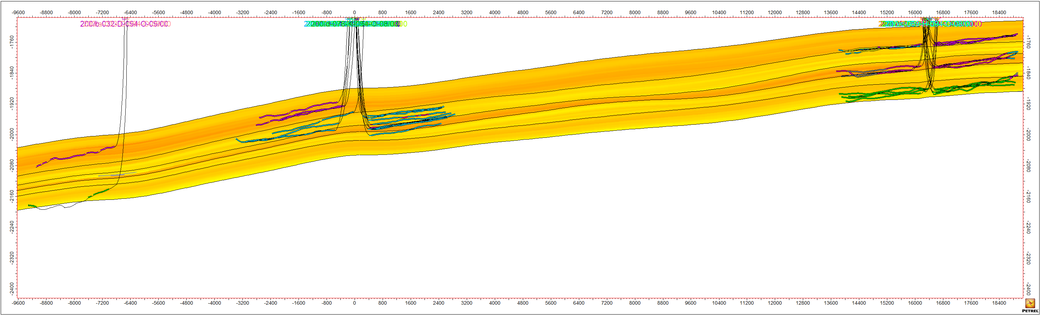
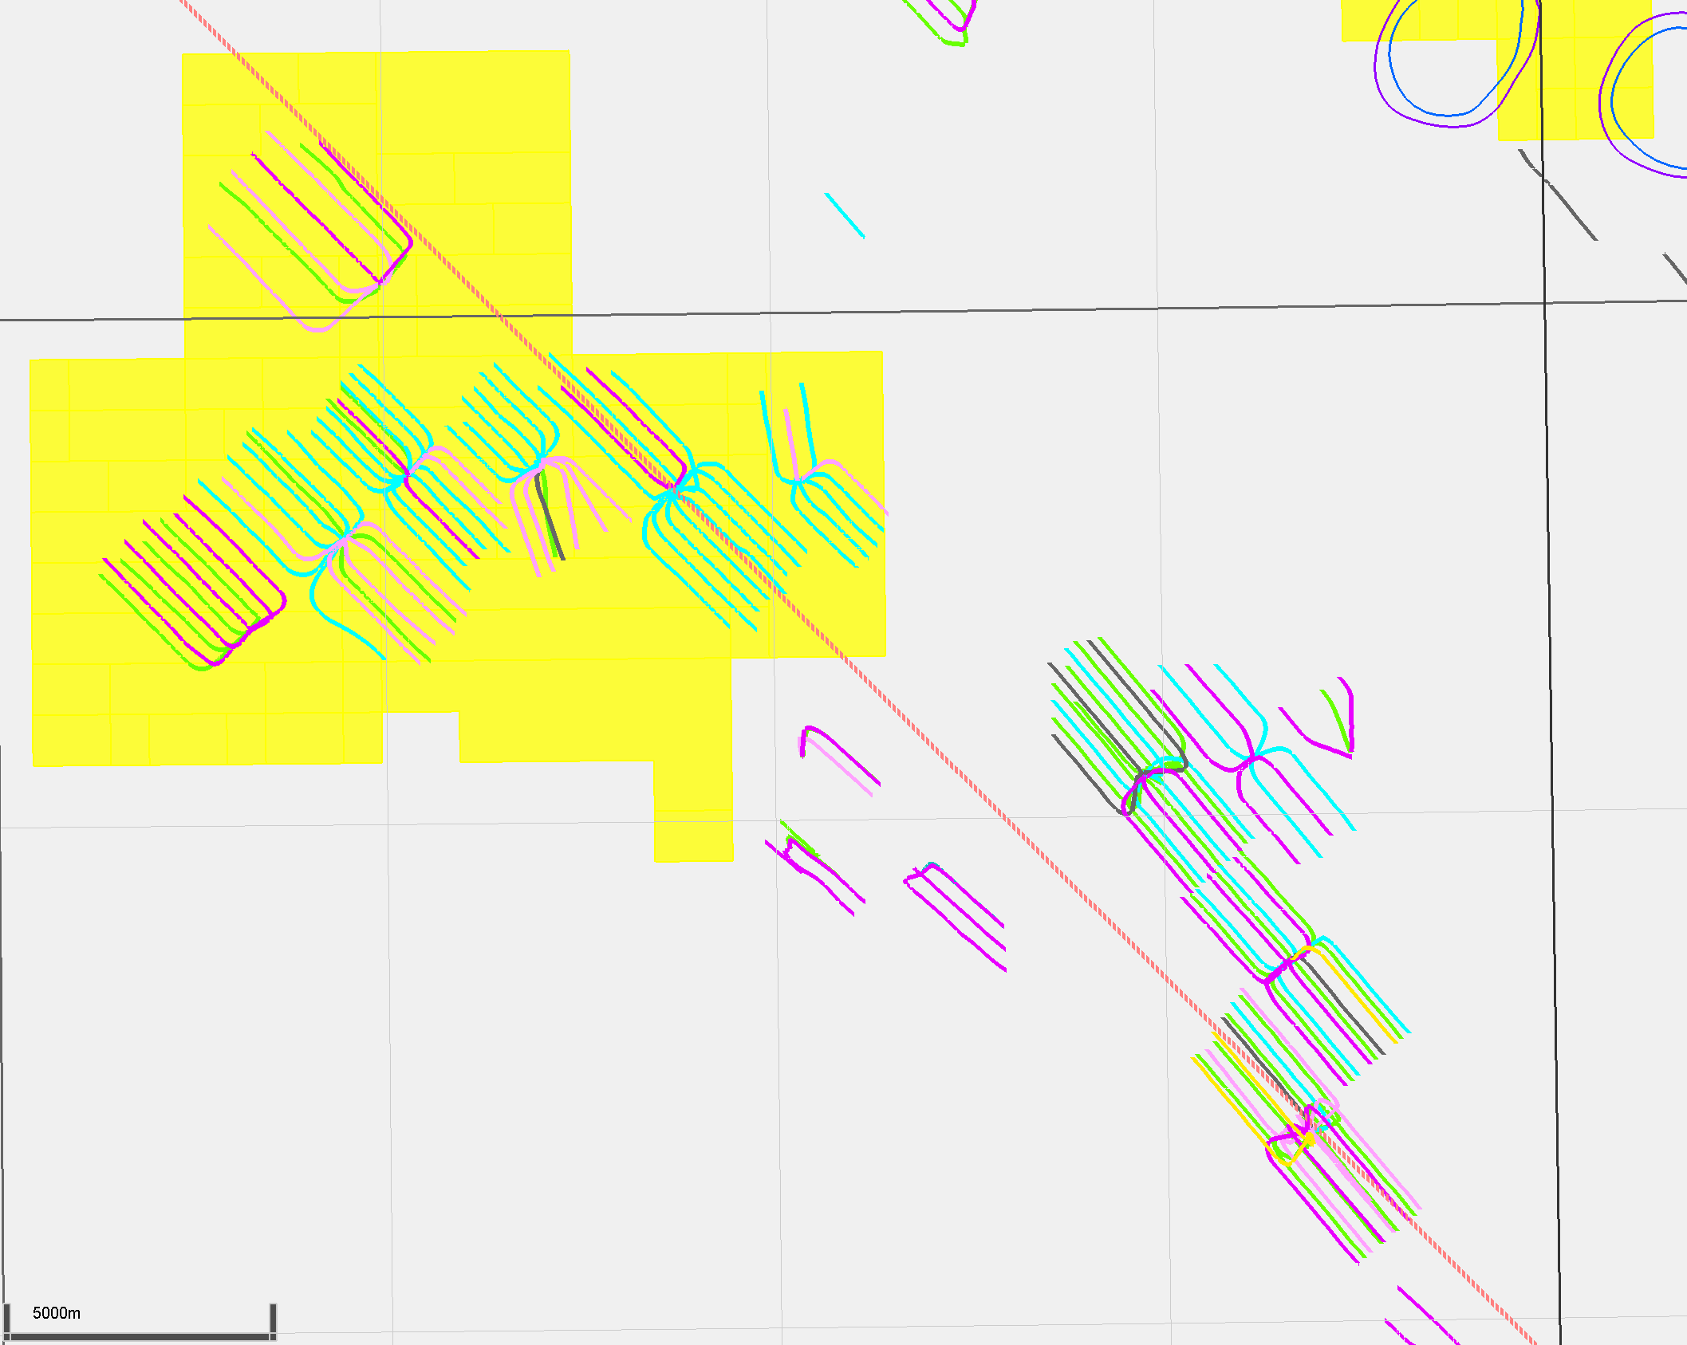
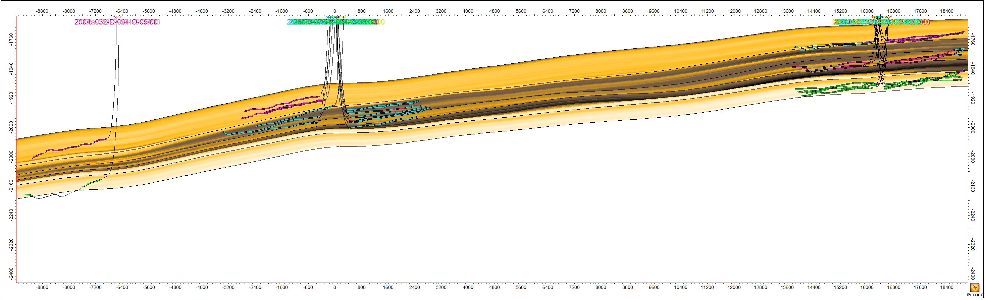
Etsho/Komie
Komie
Wells consistently target Evie, MOP, and Muskwa as distinct units
Porosity
MUSKWA
E-ZONE
MOP
MDC-LOP
EVIE
2012
Komie
63K
D1D
2009
2010
Etsho
11x vertical exaggeration
Clay Volume
MUSKWA
E-ZONE
D1D
MOP
MDC-LOP
EVIE
76K
70J
2012
70K
63K
52L
34L
Etsho
Komie
63K
D1D
2009
2010
11x vertical exaggeration
Etsho
Komie
23
NW
Komie wells are more parallel compared to Etsho
SE

Slide 24
Kiwigana/Komie
NWT
Maxhamish
Cordova Embayment
Liard Basin
Tattoo
Ootla
Bovie Fault System
Gote
Etsho
Komie
Kiwigana
Slave Point Reefs
Presqu’ile Reefs
24
Southernmost extent of development

Slide 25



Kiwigana/Komie
Kiwigana
Targets Muskwa and Evie, generally horizontal
Komie
Targets MOP
Porosity
11x vertical exaggeration
MUSKWA
E-ZONE
MOP
MDC-LOP
EVIE
2010
2012/2013
2011
Komie
Kiwigana
Clay Volume
11x vertical exaggeration
Kiwigana
MUSKWA
E-ZONE
MOP
MDC-LOP
EVIE
Komie
2010
2011
Komie
2012/2013
Kiwigana
25
NW
Parallel, no cutting across EZone
SE

Slide 26

Evie Quartz Tiering
NWT
200-d-052-L-094-O-08/00
0.05 contour interval
Quartz tiering
Green: >0.7
Yellow: >0.6
Mineral
content
GR
φ
Maxhamish
MUSKWA
Liard Basin
Tattoo
Muskwa-
OP
Ootla
Bovie Fault System
Gote
Etsho
OTTER PARK
E-ZONE
Komie
Slave Point Reefs
EZone
Kiwigana
MOP
MOP
LOP-MDC
LOP
KLUA
MDC
EVIE
Evie
Presqu’ile Reefs
KEG RIVER
26
0.45 – 0.6, low overall variability

Slide 27

Middle Otter Park Quartz Tiering
NWT
200-d-052-L-094-O-08/00
0.05 contour interval
Quartz tiering
Green: >0.7
Yellow: >0.6
Mineral
content
GR
φ
Maxhamish
MUSKWA
Liard Basin
Tattoo
Muskwa-
OP
Ootla
Bovie Fault System
Gote
Etsho
OTTER PARK
E-ZONE
Komie
Slave Point Reefs
EZone
Kiwigana
MOP
MOP
LOP-MDC
LOP
KLUA
MDC
EVIE
Evie
Presqu’ile Reefs
KEG RIVER
27
Majority 0.35 – 0.75, trends slightly lower in West

Slide 28

Muskwa Quartz Tiering
NWT
200-d-052-L-094-O-08/00
0.05 contour interval
Quartz tiering
Green: >0.7
Yellow: >0.6
Mineral
content
GR
φ
Maxhamish
MUSKWA
Liard Basin
Tattoo
Muskwa-
OP
Ootla
Bovie Fault System
Gote
Etsho
OTTER PARK
E-ZONE
Komie
Slave Point Reefs
EZone
Kiwigana
MOP
MOP
LOP-MDC
LOP
KLUA
MDC
EVIE
Evie
Presqu’ile Reefs
KEG RIVER
28
0.6 – 0.75 range, highest overall quartz

Slide 29

Evie Fairways
NWT
200-d-052-L-094-O-08/00
5 bcf/sec contour interval
OGIP tiering
Green: >50 bcf/sec
Yellow: >30 bcf/sec
Mineral
content
GR
φ
Maxhamish
MUSKWA
Liard Basin
Tattoo
Muskwa-
OP
Ootla
Bovie Fault System
Gote
Etsho
OTTER PARK
E-ZONE
Komie
Slave Point Reefs
EZone
Kiwigana
MOP
MOP
LOP
Insufficient data points to justify trends in South
LOP-MDC
KLUA
MDC
EVIE
Evie
Presqu’ile Reefs
KEG RIVER
29
Best values in centre and NW

Slide 30

Middle Otter Park Fairways
NWT
200-d-052-L-094-O-08/00
5 bcf/sec contour interval
OGIP tiering
Green: >50 bcf/sec
Yellow: >30 bcf/sec
Mineral
content
GR
φ
Maxhamish
MUSKWA
Liard Basin
Tattoo
Muskwa-
OP
Ootla
Bovie Fault System
Gote
Etsho
OTTER PARK
E-ZONE
Komie
Slave Point Reefs
EZone
Kiwigana
MOP
MOP
LOP-MDC
LOP
KLUA
MDC
EVIE
Evie
Presqu’ile Reefs
KEG RIVER
30
Best values in centre, South-centre

Slide 31

Muskwa Fairways
NWT
200-d-052-L-094-O-08/00
5 bcf/sec contour interval
OGIP tiering
Green: >50 bcf/sec
Yellow: >30 bcf/sec
Mineral
content
GR
φ
Maxhamish
MUSKWA
Liard Basin
Tattoo
Muskwa-
OP
Ootla
Bovie Fault System
Gote
Etsho
OTTER PARK
E-ZONE
Komie
Slave Point Reefs
EZone
Kiwigana
MOP
MOP
LOP-MDC
LOP
KLUA
MDC
EVIE
Evie
Presqu’ile Reefs
KEG RIVER
31
Highest overall OGIP values, best towards NW

Slide 32

MOP – Muskwa Overlap
NWT
200-d-052-L-094-O-08/00
Combined OGIP values may not be totally accessible
Must accurately determine EZone characteristics
Mineral
content
GR
φ
Maxhamish
MUSKWA
Liard Basin
Tattoo
Muskwa-
OP
Ootla
Bovie Fault System
Gote
Etsho
OTTER PARK
E-ZONE
Komie
Kiwigana
Slave Point Reefs
EZone
MOP
MOP
LOP-MDC
LOP
KLUA
MDC
EVIE
Evie
Presqu’ile Reefs
KEG RIVER
32
Best results NE of Etsho and in South

Slide 33

MOP – Muskwa Overlap
NWT
200-d-052-L-094-O-08/00
Combined OGIP values may not be totally accessible
Must accurately determine EZone characteristics
Mineral
content
GR
φ
Maxhamish
MUSKWA
Liard Basin
Tattoo
Muskwa-
OP
Ootla
Bovie Fault System
Gote
Etsho
OTTER PARK
E-ZONE
Komie
Kiwigana
Slave Point Reefs
EZone
MOP
MOP
LOP-MDC
LOP
KLUA
MDC
EVIE
Evie
Presqu’ile Reefs
KEG RIVER
33
Best results NE of Etsho and in South

Slide 34


EZone
200-d-052-L-094-O-08/00
(2 m contour interval)
EZone shows interesting thickness/ lithology trends
Clay content, thickness decrease towards the North
Mineral
content
GR
φ
MUSKWA
Muskwa-
OP
VClay
(0.025 contour interval)
OTTER PARK
E-ZONE
EZone
Thickness
MOP
MOP
LOP-MDC
LOP
KLUA
MDC
EVIE
Evie
KEG RIVER
34
EZone less of an obstacle in the North

Slide 35



EZone Barrier Thickness (35% Clay Cutoff)
NWT
200-d-052-L-094-O-08/00
(5 m contour interval)
EZone shows interesting thickness/ lithology trends
Clay content, thickness decrease towards the North
5 m contour as an example of EZone barrier tolerance
Mineral
content
Poisson’s
ratio
GR
φ
Maxhamish
MUSKWA
Liard Basin
Tattoo
Muskwa-
OP
Ootla
Bovie Fault System
Etsho
Gote
OTTER PARK
E-ZONE
Komie
Kiwigana
Slave Point Reefs
EZone
MOP
MOP
LOP-MDC
LOP
KLUA
MDC
EVIE
Evie
Presqu’ile Reefs
KEG RIVER
35
Chosen barrier criteria is significant

Slide 36


EZone Barrier Thickness
NWT
200-c-056-E-094-O-08/00
200-a-076-F-094-O-09/02
Maxhamish
GR
Mineral
content
φ
Poisson’s
ratio
GR
Mineral
content
φ
Poisson’s
ratio
Liard Basin
Tattoo
Muskwa-
OP
A’
Ootla
Bovie Fault System
Gote
Etsho
Muskwa-
OP
A
Komie
Kiwigana
Slave Point Reefs
EZone
EZone
MOP
MOP
LOP-MDC
LOP-MDC
Evie
Evie
Presqu’ile Reefs
36
A
A’
EZone variability is evident in logs

Slide 37

Volumetrics
Nitrogen
~0.01 throughout
H2S
None or trace amounts throughout
CO2
Muskwa: 0.095
MOP: 0.108
Evie: 0.136
HCPV = thickness*porosity*gas saturation
OGIP = (43,560*640*HCPV/Bg) /1,000,000
MOP gas saturation
NWT
0.05 contour interval
Liard Basin
Bovie Fault System
Slave Point Reefs
Presqu’ile Reefs
37
Workflow incorporates existing Bg values

Slide 38


MOP – Muskwa OGIP
NWT
200-d-052-L-094-O-08/00
(5 bcf/sec contour interval)
Combined OGIP values may not be totally accessible
Northern area has best criteria
Landing zone thickness may be a limiting factor
Mineral
content
GR
φ
Maxhamish
MUSKWA
Tattoo
Ootla
Liard Basin
Muskwa-
OP
Bovie Fault System
Etsho
OTTER PARK
E-ZONE
Slave Point Reefs
EZone
MOP
MOP
LOP-MDC
LOP
KLUA
MDC
EVIE
Evie
Presqu’ile Reefs
Landing Zone Thickness
KEG RIVER
38
EZone barrier thickness as a limit to OGIP map

Slide 39

MDC – LOP Barrier Thickness
NWT
200-d-052-L-094-O-08/00
(5 m contour interval)
Can make similar map for MDC – LOP thickness
Barrier does fall below 5 m in one area
Targeting the entire formation is probably inefficient
Mineral
content
GR
φ
Maxhamish
MUSKWA
Liard Basin
Tattoo
Ootla
Overlap
Muskwa-
OP
Bovie Fault System
Etsho
OTTER PARK
E-ZONE
Slave Point Reefs
EZone
MOP
MOP
LOP-MDC
LOP
KLUA
MDC
EVIE
Evie
Presqu’ile Reefs
KEG RIVER
39
Despite overlap, landing below LOP not optimal

Slide 40
Adsorbed Gas
Makes up significant portion of total gas for Horn River
Overall estimates for adsorbed gas in basin demonstrate significant difference in free gas vs OGIP
Ultimate effects of adsorbed gas on production are unclear
Average free and adsorbed gas, Horn River member
Gas component volume
Gas component % =
Total gas volume
% Adsorbed
% Free
40
Dissolved gas-in-place very small, ignored

Slide 41

Conclusion
Project outcomes
Increased understanding of Horn River Basin
Updated stratigraphy, incorporated more data and quality control
Modelled petrophysical data by characterizing porosity, mineralogy, saturation, pressure, temperature, and gas impurities
OGIP calculations and landing zone analysis for fairway mapping
41

Slide 42
Conclusion
Continue developing Horn River Strategy
Next Steps
Compare with analogues
Production analysis
Integrate property maps to understand production drivers
Tier Horn River acreage
Key Landing Zone Properties
Property | Evie | MOP | OP-Muskwa
Max Thickness (m) | 76 | 47 | 85
Porosity (frac) | 0.02-0.06 | 0.04-0.07 | 0.03-0.06
Water Saturation (frac) | 0.1-0.2 | 0.1-0.3 | 0.2-0.4
VClay (frac) | 0.06-0.24 | 0.04-0.51 | 0.09-0.25
VQuartz (frac) | 0.45-0.6 | 0.35-0.75 | 0.6-0.75
Best OGIP (bcf/sec) | 53 | 64 | 79
Landings (including EZone) | 77 | 99 | 156
42

Slide 43
Questions
43

Slide 44
Back-up Slides
44

Slide 45



Pressure and Temperature
Temperature
Pressure Gradient
Absolute Pressure
NWT
NWT
NWT
5°C contour interval
(1 MPa/m contour interval)
(1 MPa contour interval)
Bovie Fault System
Bovie Fault System
Bovie Fault System
Slave Point Reefs
Slave Point Reefs
Slave Point Reefs
Presqu’ile Reefs
Presqu’ile Reefs
Presqu’ile Reefs
99 – 165 °C range
9 – 20 MPa/m range
18 – 58 MPa range
Values calculated for Horn River as a whole. Lower confidence in Southern areas
45

Slide 46

Additional Land Rights, Operators
NWT
Maxhamish
EOG wells
POU 50%, CNRL
Tattoo
Liard Basin
NTE Energy wells
Ootla
POU 60%, Cenovus
EOG wells
Bovie Fault System
Etsho
POU 55% Crew, Cenovus
POU 50%, Ovintiv
POU 50%, CNRL
CNOOC wells
Kiwigana
CNRL wells
Komie
OVV wells
POU 65%, Cenovus
Slave Point Reefs
POU 50%, CNRL
Tallahassee Expl wells
POU 60%, NTE Energy
Presqu’ile Reefs
46

Slide 47

47

Slide 48

High stress zone in fault area
High stress
More difficult completion
48
ISIP: proxy for Shmin

Slide 49

Mapping stress variation from seismic
Integration of 1D geo-mechanical model with inverted seismic data
49
Risk of high stress zone on 52L pad

Slide 50

CO2 Map, Fluid Impurities
CO2
Ranges from 9%-16%
Data availability limits point spread
Nitrogen
Approximately 1% throughout
H2S
None or trace amounts
(0.01 contour interval)
NWT
Ootla
Bovie Fault System
Etsho
Slave Point Reefs
Presqu’ile Reefs
50
Up to 0.16 CO2

Slide 51



Bg Maps
Evie
MOP
Muskwa
51

Slide 52

Horn River Thickness
430 m maximum thickness
52

Slide 53

EZone OGIP
NWT
Maxhamish
Cordova Embayment
Liard Basin
Tattoo
Ootla
Bovie Fault System
Gote
Etsho
Komie
Kiwigana
Slave Point Reefs
Presqu’ile Reefs
53

Slide 54

EZone Barrier Thickness (25% Clay Cutoff)
200-d-052-L-094-O-08/00
NWT
Mineral
content
Cordova Embayment
GR
φ
Maxhamish
MUSKWA
Liard Basin
Ootla
Muskwa-
OP
Bovie Fault System
Etsho
OTTER PARK
E-ZONE
Slave Point Reefs
EZone
MOP
MOP
LOP-MDC
LOP
KLUA
MDC
EVIE
Evie
Presqu’ile Reefs
KEG RIVER
54

Slide 55


Vertical Depth
(100 m contour interval)
Surface elevation from NRCAN DEM data and co-gridding with well surface data
Bovie Fault System
Surface elevation
Slave Point Reefs
--sea level
MUSKWA
(top of Horn River Member)
NW
Presqu’ile Reefs
Horn River 1700 – 3200 m deep
55

Slide 56
Horn River Thickness
430 m maximum thickness
56

